Slide 1
Considering An Electric School Bus?
The Economics: What you need to know

Slide 2
There are still barriers for this transition
Higher upfront costs
Concern with change and unfamiliar technology
Perceived technological readiness (e.g. range)
New business models to consider
These impact underserved communities disproportionately
Notes:
Drawing on our etransit work around the world, we find there are 4 main barriers for implementation,
Barrier 1: Higher upfront costs
Barrier 2: Fear of change and unfamiliar technology
Barrier 3: Technology is more of a perceived barrier, since there are plenty of routes districts could electrify today.
Barrier 4: Outdated procurement models
These Barriers disproportionately impact disadvantaged communities
This presentation focuses on the First Barrier, and in doing so touches on some of the others as well.

Slide 3
There are still barriers for this transition
Exacerbated Challenges:
Access to capital, such as higher cost to borrow & lower tax base
Staff capacity to manage project
Underinvested local electrical distribution infrastructure
Outsize Benefits:
Air quality improvements result in greater local health benefits
Operational savings & revenue generation to support district priorities
Inclusion in green economy

Slide 4
GLOSSARY & KEY FINANCIAL TERMS
ESB: Electric school Bus
ICE Bus: Internal Combustion Engine Bus – in this presentation, assumed to be diesel
Interest Rate: the proportion of a loan that is charged as interest to the borrower, typically expressed as an annual percentage of the loan outstanding
M&R: Maintenance and Repair
MSRP: Manufacturer’s Stated Retail Price
NPV: Net Present Value – the sum of a series of dollar amounts expected in the future, discounted in terms of today’s dollars to account for inflation, interest rates/cost of capital, etc.
Source: WRI, Investopedia, Oxford Dictionary

Slide 5
GLOSSARY & KEY FINANCIAL TERMS
RoR: Rate of Return – the net gain or loss of an investment over a specified time period, expressed as a percentage of the investment's initial cost
TCO: Total Cost of Ownership – the sum of all current and future capital and operating expenses associated with ownership of an asset; for school buses, this incudes:
upfront purchase price of the vehicle
upfront purchase price of charging infrastructure
upfront grants or incentives to subsidize purchases
future annual fuel expenditures
future cost of maintenance and repair
any revenues from energy or environmental market payments
registration fees, insurance, etc.
Source: WRI, Investopedia, Oxford Dictionary

Slide 6
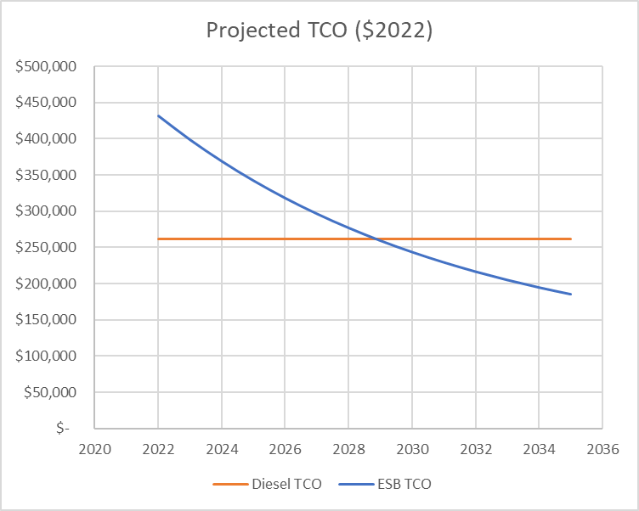
The costs of ESBs are declining
Price parity is projected by 2033 and TCO parity is projected by 2029 as:
Battery costs decline
Industry efficiencies of scale in component markets
Market prices are distinct from the prices districts pay due to government & utility subsidies
With incentives, many ESB purchases already achieve TCO parity with diesels
Source: WRI calculations (February 2022)
Notes:
Price parity projected by 2033
TCO parity projected by 2029
Subsidies today will not last forever, so now is the time!

Slide 7
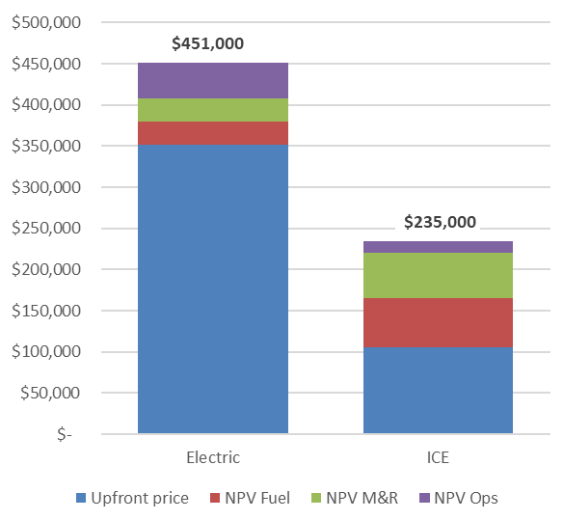
Unsubsidized ESBs are currently more costly than ICE buses
Lifetime TCO, Maryland
Key Parameters | New Electric | New Diesel (ICE)
Upfront MSRP | $347,000 | $106,000
Fuel price | $0.113/kWh | $2.81/Gallon
Fueling infrastructure | Level 2 charger | n/a
Annual mileage | 13,000
Vehicle lifetime | 15 years
Upfront difference: $(246,000)
TCO difference: $(217,000)
Source: WRI calculations (February 2022)
Notes:
Unsubsidized costs are substantially higher than for diesel
In the table, I’ve laid out some key parameters for this calculation
To the extent feasible, these calculations are based on real-world numbers districts have shared with us
Blue is upfront cost, including charger & infrastructure – see Electric > ICE
CLICK – This delta is $241k
But we know that considering lifetime costs should change the narrative, at least somewhat
Red is Fuel – ICE > Electric
Green is Maintenance and Repair – again, ICE > Electric
Notice the Purple – Operations:
This illustrates with insurance costs at 3% of the vehicle residual value -- a notable delta for ESBs
CLICK – in this case, the operational savings from the Electric are only $24,000 over the vehicle lifetime, which barely makes a dent in that upfront delta

Slide 8
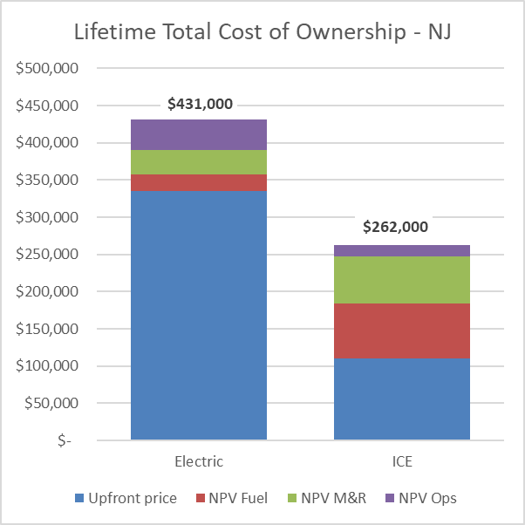
These costs vary by state and underlying assumptions
Lifetime TCO, Maryland
Lifetime TCO, New Jersey
Lifetime TCO, New Jersey
Key Parameters | New Electric | New Diesel (ICE)
Upfront MSRP | $330,000 | $110,000
Fuel price | $0.078/kWh | $2.81/Gallon
Fueling infrastructure | Level 2 charger | n/a
Annual mileage | 15,000
Vehicle lifetime | 15 years
TCO difference: $(169,000)
Upfront difference: $(225,000)
Source: WRI calculations (February 2022)
Notes:
It is important to emphasize that the calculus shifts depending on assumptions
In this analysis for NJ, we’ve changed
CLICK
the vehicle prices,
Updated the electricity price based on differences in rates in different states,
and bumped up vehicle mileage (15k annually is about 83 miles per vehicle per 180 school days)
In combination this amounts to $56k in operating savings over the lifetime – this is addresses just one quarter of that upfront premium.

Slide 9
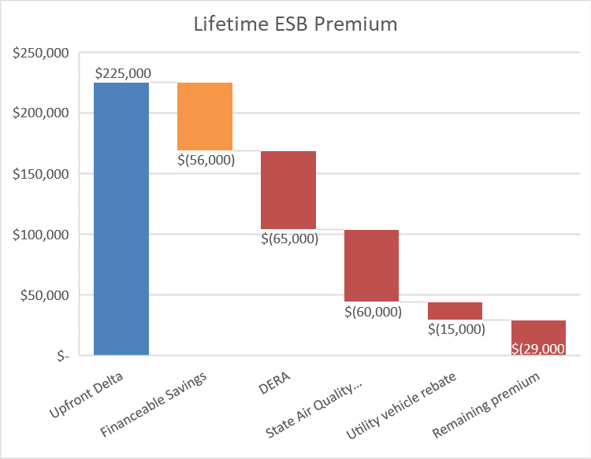
The subsidized costs of ESBs (is lower than you may think!)
Lifetime TCO, Maryland
TCO delta: $(169,000)
Source: WRI calculations (February 2022), illustrative grant program details
Notes:
Luckily for districts, we are still at a place where there are significant subsidies in the market that help make a dent in the ESB premium
CLICK
You can see the financeable portion of the upfront cost in ORANGE
We’re sticking a pin in that and will return later
The boxes in red are illustrative funding sources and amounts that can be stacked together to address the ESB premium

Slide 10
WHEN ALL DOLLARS NOT EQUAL
On-the-hood
Discount
Incentive
Rebate
Tax Credit
Award
Voucher
Grant
Matching funds
Point-of-Sale
Refund
Notes:
There are many different types of public funding, or subsidies, that support ESB adoption.
I’m not going to go into all of these, but wanted to run through some definitions and tradeoffs for some key types, with a key takeaway being that all dollars are not created equal – the characteristics of different award types can lead to notable disparities between districts in their abilities to take advantage of funding sources

Slide 11
TYPES OF FUNDING: GRANT
Definition | Advantages | Disadvantages
An award made to qualifying applicants, for a specific purpose or use case, deemed the worthiest based on set criteria. Often awarded on a competitive basis. Typically, does not cover ongoing fueling, maintenance, or other operating costs. | Generally, directs aid to priority districts. Often covers planning and project management costs. | Applications can sometimes be time intensive and onerous.
Social equity considerations
Application processes can apply an undue burden on under-resourced school districts that have lower capacity to apply for funding.
Other considerations
Funds are not guaranteed until won/awarded, which can hinder budget planning.
Notes:
First are Grant funds
An award made to qualifying applicants, for a specific purpose or use case, deemed the worthiest based on set criteria.
Often awarded on a competitive basis
Typically do not cover ongoing fueling, maintenance, or other operating costs.
Advantages:
Generally better suited to directing aid to priority districts;
Often cover planning and project management costs.
Disadvantages
Applications can be time intensive and onerous.
CLICK
The social equity implication of this means application processes can place an undue burden on low-resourced school districts that have lower capacity to respond to applications
CLICK
Additionally, there is a delay between application and award, which can hinder districts’ budgeting abilities

Slide 12
TYPES OF FUNDING: GRANT
Grants are awarded on a competitive basis to qualifying applicants
Advantages
Helps direct aid to priority districts
Often covers planning + project management costs
Disadvantages
Applications can be intensive
Equity considerations
Application can place undue burden on under-resourced districts
Other considerations
Funds not guaranteed until awarded, which can hinder planning
Notes:
First are Grant funds
An award made to qualifying applicants, for a specific purpose or use case, deemed the worthiest based on set criteria.
Often awarded on a competitive basis
Typically do not cover ongoing fueling, maintenance, or other operating costs.
Advantages:
Generally better suited to directing aid to priority districts;
Often cover planning and project management costs.
Disadvantages
Applications can be time intensive and onerous.
The social equity implication of this means application processes can place an undue burden on low-resourced school districts that have lower capacity to respond to applications
Additionally, there is a delay between application and award, which can hinder districts’ budgeting abilities

Slide 13
TYPES OF FUNDING: REBATES
Definition | Advantages | Disadvantages
A reimbursement after certain eligible purchases of preapproved equipment. | Limited paperwork. A preapproved equipment list reduces the burden on applicants and simplifies purchase decisions. | Rarely differentiates potential beneficiaries in a nuanced manner. Requires the recipient to pay full price at the time of purchase.
Social equity considerations
Lower administrative burden may facilitate equitable disbursement of funds regardless of differential resources & capacity of school districts.
Districts need cash on-hand to make purchases and must be able to weather delayed reimbursement processes, which may unduly burden districts that do not have budget flexibility.
Note: Refundable tax credits expected to operate similar to rebates
Notes:
Another type of funding is something that you’re likely familiar with in your own life – rebates
A reimbursement after purchasing eligible, preapproved equipment.
Advantages
Limited paperwork. A preapproved equipment list reduces the burden on applicants and simplifies purchase decisions.
Disadvantages
Rarely differentiate potential beneficiaries in a nuanced manner
Requires the recipient to pay full price at the time of purchase
CLICK
The social equity implications of this funding format are mixed
On the one hand, lower administrative burden may facilitate equitable disbursement of funds regardless of the disparate resources & capacities across school districts.
CLICK
On the other hand, districts need cash on-hand to make purchases and must be able to weather delayed reimbursement processes, which may unduly burden districts that do not have budget flexibility.
CLICK
Another note is that as a policy, tax credits, ESPECIALLY refundable tax credits like those under consideration in the Build Back Better, are actually pretty similar to rebates in function and most of these same advantages and disadvantages apply.

Slide 14
TYPES OF FUNDING: REBATES
Rebates – a reimbursement after eligible purchases of equipment
Advantages
Limited paperwork
Preapproved equipment list simplifies purchasing decisions
Disadvantages
Recipient must pay full price at time of purchase
Depending on programmatic design, rebates can more closely resemble vouchers with payout upon submission of a purchase order, thus mitigating this risk
Equity considerations
Lower administrative burden can facilitate equitable disbursement of funds
Reimbursement processes can burden districts without budget flexibility
Notes:
Another type of funding is something that you’re likely familiar with in your own life – rebates
A reimbursement after purchasing eligible, preapproved equipment.
Advantages
Limited paperwork. A preapproved equipment list reduces the burden on applicants and simplifies purchase decisions.
Disadvantages
Rarely differentiate potential beneficiaries in a nuanced manner
Requires the recipient to pay full price at the time of purchase
CLICK
The social equity implications of this funding format are mixed
On the one hand, lower administrative burden may facilitate equitable disbursement of funds regardless of the disparate resources & capacities across school districts.
CLICK
On the other hand, districts need cash on-hand to make purchases and must be able to weather delayed reimbursement processes, which may unduly burden districts that do not have budget flexibility.
CLICK
Another note is that as a policy, tax credits, ESPECIALLY refundable tax credits like those under consideration in the Build Back Better, are actually pretty similar to rebates in function and most of these same advantages and disadvantages apply.

Slide 15
TYPES OF FUNDING: VOUCHERS
Definition | Advantages | Disadvantages
Reduce point-of-sale prices for eligible purchases of preapproved equipment. | Limited paperwork. A preapproved equipment list reduces the burden on applicants and simplifies purchase decisions. | Rarely differentiates potential beneficiaries in a nuanced manner. Funds only for equipment, not other necessary project costs.
Social equity considerations
Lower administrative burden to receive point-of-sale incentives may facilitate equitable disbursement of funds regardless of differential resources & capacity of school districts.
Does not require districts to have cash on-hand.
Notes:
The last type is Vouchers, which
Reduce point-of-sale prices for eligible purchases of preapproved equipment
In many ways vouchers are similar to rebates, key difference being that because the discount is applied at the outset, these programs do not require districts to have cash-on-hand to cover costs and then wait for some time while repayment is processed

Slide 16
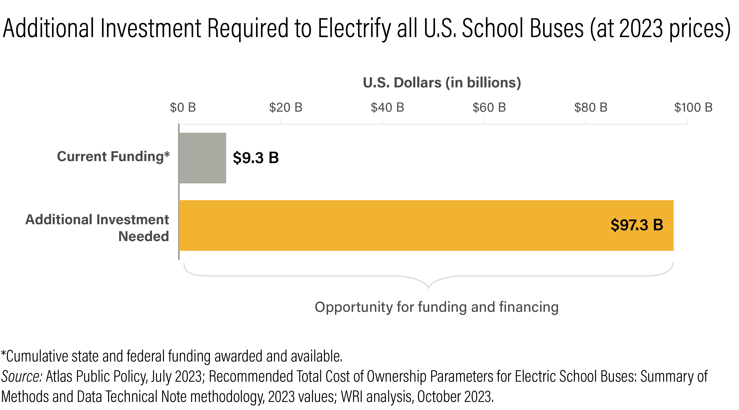
Public funding alone will not solve the upfront cost gap
480,000
Notes:
…but this should be a temporary problem
Price parity projected by no later than 2033
TCO parity projected by no later than 2029

Slide 17
Public funds can be a significant aid
Cost category | 1st Bus
Upfront cost difference | $(225,000)
Public Funds applied | $250,000 from Clean School Bus Program
District Surplus | $25,000
In this scenario, the school district gets 1 bus and a surplus of $25,000
Source: WRI calculations (February 2022), illustrative grant program details
Notes:
Luckily for districts, we are still at a place where there are significant subsidies in the market that help make a dent in the ESB premium
CLICK
You can see the financeable portion of the upfront cost in ORANGE
We’re sticking a pin in that and will return later
The boxes in red are illustrative funding sources and amounts that can be stacked together to address the ESB premium

Slide 18
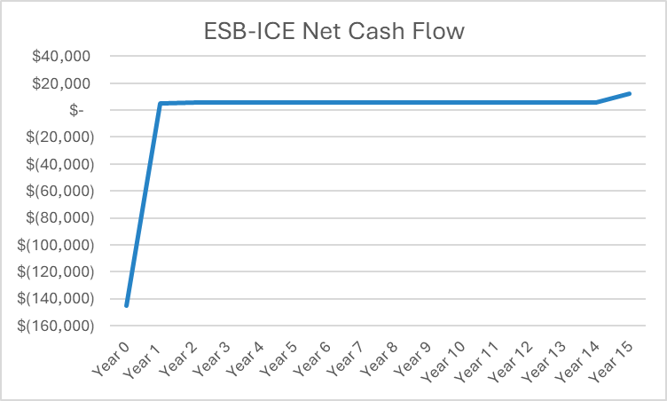
Financing provides capital today, for future repayment
Positive cash flow is the revenue for repaying loan
Source: WRI calculations (February 2022), illustrative grant program details & illustrative cash flow
Notes:
See the financeable portion of the upfront cost in ORANGE
We’re sticking a pin in that and will return later

Slide 19
Finance can leverage public funds to increase project scale
Cost category | 1st Bus | Leveraged 2nd Bus
Upfront cost difference | $(225,000) | $(225,000)
Financeable Savings | $56,000 | $56,000
Public Funds applied | $250,000 from Clean School Bus Program | $65,000 from DERA $20,000 from local utility
Financing applied | n/a | $56,000 Bus 1 financeable savings $25,000 Bus 1 surplus
District Surplus | $25,000 | $(3,000)
Whereas in this scenario, the district gets TWO buses even though on their own, the amount of public funding was insufficient to cover two buses.
Source: WRI calculations (February 2022), illustrative grant program details
Notes:
Luckily for districts, we are still at a place where there are significant subsidies in the market that help make a dent in the ESB premium
CLICK
You can see the financeable portion of the upfront cost in ORANGE
We’re sticking a pin in that and will return later
The boxes in red are illustrative funding sources and amounts that can be stacked together to address the ESB premium

Slide 20
Funding & financing have complementary roles
Public Funds Required
Overall Savings
Financing Required
Financing Required to Leverage Public Funds
2033 Price Parity
Source: WRI illustrative calculations (February 2022)
Notes:
Fleets transitioning today utilize public funding to improve purchase economics of ESBs
Electrification will generate overall savings for procurements in years after TCO parity is achieved

Slide 21
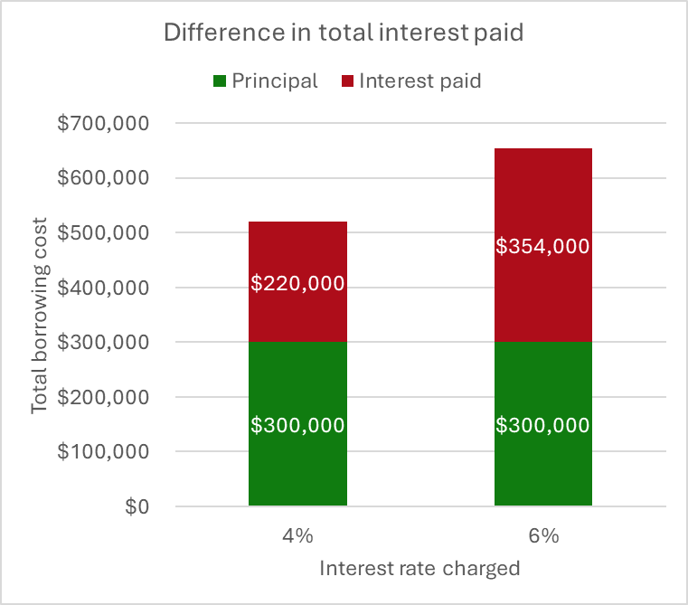
MORTGAGE PARALLEL: 30-YEAR LOAN
Principal: $300,000
Low Interest Rate: 4%
Lifetime interest: $220,000
Principal: $300,000
High Interest Rate: 6%
Lifetime interest: $354,000
Principal
Interest
Source: WRI calculations (July 2022), illustrative grant program details & illustrative cash flow
Notes:
This mortgage finance example illustrates the way interest accumulates.

Slide 22
Financing provides capital today for future repayment
Principal
Interest
Source: WRI calculations (July 2022), illustrative grant program details & illustrative cash flow
Notes:
See the financeable portion of the upfront cost in ORANGE
Positive cash flow amounts to the operating savings generated by reduced fueling & maintenance costs
This total amount can cover the Principal and Interest of a financing deal

Slide 23
Rate of return varies across lenders
Higher payoff
Risk appetite drives investors’ expected return.
From borrowers’ perspective, rate of return is the price borrowers pay in terms of interest on initial investment.
Higher risk
Return
(% increase on initial investment)
Lower payoff
Lower risk
Risk
(uncertainty of achieving return)
Source: Adapted from Investopedia
Notes:
Different types of financial institutions have distinct risk appetites. Those that take on higher levels of risk expect to be compensated with the possibility of higher returns, or payoffs.

Slide 24
Expected return varies by capital source
Source | Grants | Venture capital | Commercial debt | Project finance | Public finance
Expected Rate of Return | 0% | 30%+ | 5-15% | 5-15% | ~0-5%
Ownership stake | N | Y | N | N | N
Complexity | HIGH | MED | HIGH | HIGH | MED
Market Stage | Early | Early, Growth | Growth, Mature | Growth, Mature | All
Adapted from: https://climatetechvc.substack.com/p/-the-climate-capital-stack

Slide 25
Expected return varies by capital source
Source | Grants | Venture capital | Commercial debt | Project finance | Public finance
Expected Rate of Return | 0% | 30%+ | 5-15% | 5-15% | ~0-5%
Ownership stake | N | Y | N | N | N
Complexity | HIGH | MED | HIGH | HIGH | MED
Market Stage | Early | Early, Growth | Growth, Mature | Growth, Mature | All
Grants
0%
N
HIGH
Early
Adapted from: https://climatetechvc.substack.com/p/-the-climate-capital-stack

Slide 26
Expected return varies by capital source
Public finance
~0-5%
N
MED
All
Source | Grants | Venture capital | Commercial debt | Project finance | Public finance
Expected Rate of Return | 0% | 30%+ | 5-15% | 5-15% | ~0-5%
Ownership stake | N | Y | N | N | N
Complexity | HIGH | MED | HIGH | HIGH | MED
Market Stage | Early | Early, Growth | Growth, Mature | Growth, Mature | All
Grants
0%
N
HIGH
Early
Adapted from: https://climatetechvc.substack.com/p/-the-climate-capital-stack

Slide 27
Expected return varies by capital source
Public finance | Commercial debt
~0-5% | 5-15%
N | N
MED | HIGH
All | Growth, Mature
Source | Grants | Venture capital | Commercial debt | Project finance | Public finance
Expected Rate of Return | 0% | 30%+ | 5-15% | 5-15% | ~0-5%
Ownership stake | N | Y | N | N | N
Complexity | HIGH | MED | HIGH | HIGH | MED
Market Stage | Early | Early, Growth | Growth, Mature | Growth, Mature | All
Grants
0%
N
HIGH
Early
Adapted from: https://climatetechvc.substack.com/p/-the-climate-capital-stack

Slide 28
Expected return varies by capital source
Public finance | Commercial debt | Project finance
~0-5% | 5-15% | 5-15%
N | N | N
MED | HIGH | HIGH
All | Growth, Mature | Growth, Mature
Source | Grants | Venture capital | Commercial debt | Project finance | Public finance
Expected Rate of Return | 0% | 30%+ | 5-15% | 5-15% | ~0-5%
Ownership stake | N | Y | N | N | N
Complexity | HIGH | MED | HIGH | HIGH | MED
Market Stage | Early | Early, Growth | Growth, Mature | Growth, Mature | All
Grants
0%
N
HIGH
Early
Adapted from: https://climatetechvc.substack.com/p/-the-climate-capital-stack

Slide 29
Expected return varies by capital source
Public finance | Commercial debt | Project finance | Venture capital
~0-5% | 5-15% | 5-15% | 30%+
N | N | N | Y
MED | HIGH | HIGH | MED
All | Growth, Mature | Growth, Mature | Early, Growth
Source | Grants | Venture capital | Commercial debt | Project finance | Public finance
Expected Rate of Return | 0% | 30%+ | 5-15% | 5-15% | ~0-5%
Ownership stake | N | Y | N | N | N
Complexity | HIGH | MED | HIGH | HIGH | MED
Market Stage | Early | Early, Growth | Growth, Mature | Growth, Mature | All
Grants
0%
N
HIGH
Early
Adapted from: https://climatetechvc.substack.com/p/-the-climate-capital-stack

Slide 30
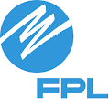
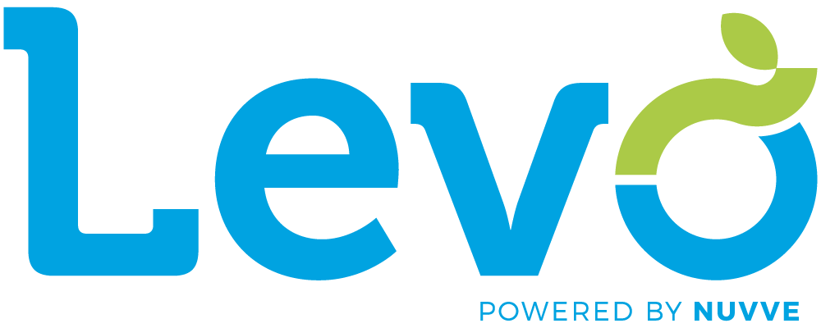
Expected return varies by capital source
Source
Expected Rate of Return
Examples
Venture capital | Commercial debt | Project finance | Public finance
30%+ | 5-15% | 5-15% | ~0-5%
Grants
0%
State & local general obligation bonds
ARP, DERA, BIF, BBB, HVIP, etc
Current model for most districts
Adapted from: https://climatetechvc.substack.com/p/-the-climate-capital-stack

Slide 31
Types of Financing: VENTURE CAPITAL
Definition | Advantages | Disadvantages
Capital that is invested in an early-stage company, typically in exchange for an equity stake. School districts are unlikely to directly engage venture capital to finance their purchases but may indirectly engage it through partnership with firms that use venture capital to capitalize deals. | Accepts higher risk than most other sources of capital. | Investors expect high returns to compensate for high risk, meaning capital is expensive.
Social equity considerations
Districts may not avail themselves of lower cost capital sources if they do not recognize when high cost capital is embedded in deals

Slide 32
Types of Financing: VENTURE CAPITAL
Venture capital is capital invested in early-stage company, typically in exchange for equity stake
Advantages
Accepts higher risk than most other sources of capital
Disadvantages
Expensive - investors expect high returns to compensate for high risk
Equity considerations
Districts may not recognize when high-cost capital is embedded in certain deals
Notes:
Capital that is invested in an early-stage company, typically in exchange for an equity stake.
School districts are unlikely to directly engage venture capital to finance their purchases but may indirectly engage it through partnership with firms that use venture capital to capitalize deals.
Accepts higher risk than most other sources of capital.
Investors expect high returns to compensate for high risk, meaning capital is expensive.
Social equity considerations
Districts may not avail themselves of lower cost capital sources if they do not recognize when high cost capital is embedded in deals

Slide 33
Types of Financing: COMMERCIAL DEBT
Definition | Advantages | Disadvantages
A sum of money lent by a private entity for future repayment, with terms set at the outset based upon the creditworthiness of the borrower. Loans may be secured by other assets held as collateral. | Debt is generally a low-cost form of capital for borrowers because the fixed payment stream entails low risk for the lender. | Private borrowers like OEMs or bus contractors, might face interest rates of ~5-10% from banks and financial institutions.
Social equity considerations
The creditworthiness of school districts reflects societal inequities; borrowers that are measured or perceived to have a higher risk of default will be offered higher interest rates where the additional return to the lender is meant to compensate for the higher risk.

Slide 34
Types of Financing: COMMERCIAL DEBT
Commercial debt is private money lent for future repayment
Advantages
Generally low-cost form of capital due to fixed payment stream + low risk for lender
Disadvantages
Private borrowers can face relatively high interest rates of ~5-10%
Equity considerations
Creditworthiness of school districts reflects social inequities; borrowers perceived to have higher risk of default will be offered higher interest rates
Notes:
A sum of money lent by a private entity for future repayment, with terms set at the outset based upon the creditworthiness of the borrower.
Loans may be secured by other assets held as collateral.
Debt is generally a low-cost form of capital for borrowers because the fixed payment stream entails low risk for the lender.
Private borrowers like OEMs or bus contractors, might face interest rates of ~5-10% from banks and financial institutions.
Social equity considerations
The creditworthiness of school districts reflects societal inequities; borrowers that are measured or perceived to have a higher risk of default will be offered higher interest rates where the additional return to the lender is meant to compensate for the higher risk.

Slide 35
Types of Financing: COMMERCIAL DEBT
INCLUSIVE UTILITY INVESTMENTS
Definition | Advantages | Disadvantages
aka “tariffed on-bill investments” A Type of commercial debt, utilities provide upfront capital to pay for upgrades at customer site and recover costs through a fixed charge on the customer’s utility bill. The charge takes into account installation costs, administrative costs, estimated savings, and cash flow. | IUIs are not traditional debt so no credit rating required. Charges are set at levels that ensure immediate savings. Charges are tied to site meter that receives electrification investment regardless of whether customer leaves. | Utility regulators must approve programs. Where TCO is not at parity, matching funds from other sources are still necessary.
Social equity considerations
Many districts that have low capacity are not able to self-finance through issuance of additional bonds, so IUIs are an alternative for raising capital.
Source: Clean Energy Works (https://www.cleanenergyworks.org/2022/01/01/introduction-to-inclusive-utility-investments/)

Slide 36
Types of Financing: COMMERCIAL DEBT (IUIs)
Inclusive Utility Investments (IUIs) are commercial debt provided by utilities to pay for upgrades at a customer site
Advantages
No credit rating required
Charges are set at levels that ensure immediate savings
Disadvantages
Utility regulators must approve programs
Matching funds from other sources may still be necessary
Equity considerations
IUIs are an alternative for districts unable to self-finance through issuance of additional bonds

Slide 37
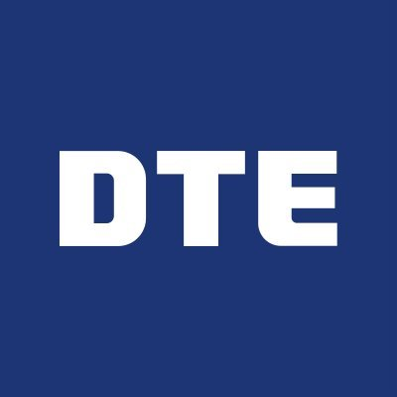
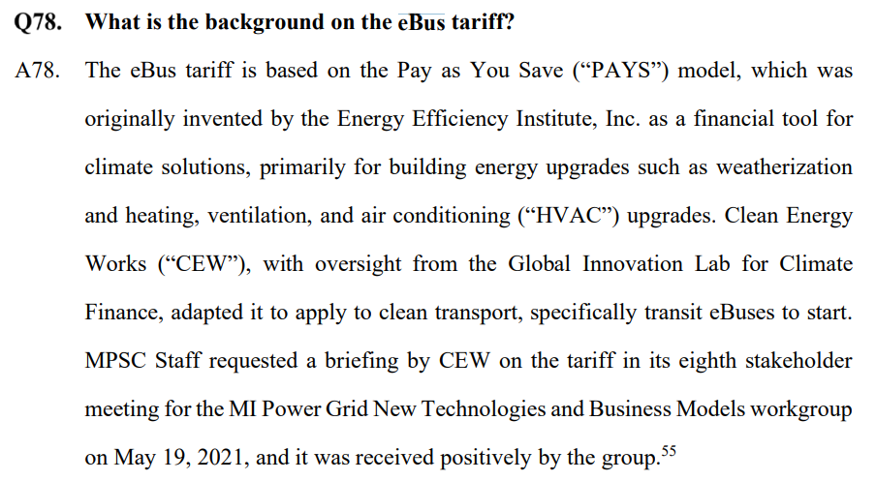
Debt: Commercial – Utility Financing
Source: DTE Energy’s Twitter account (7/5/22); DTE Energy filing in MPSC Case No. U-20836 2022 rate proceeding (1/21/22)

Slide 38
Types of Financing: COMMERCIAL DEBT
TAX-EXEMPT LEASE (PURCHASE)
Definition | Advantages | Disadvantages
Leases are contracts that allow use of equipment for a set period of time in return for regular payments to a third party (lessor). Leases can come with a purchase option that can be exercised at the end of the lease period. | Faster and more flexible than bond financing. Interest rates are lower than commercial agreements because interest payments are exempt from federal income tax. Leases are part of operating budget, so no debt is incurred. | Interest cost is higher than that of a general obligation bond. If the district does not appropriate funds for purchase at end of term, the district will lose the equity that was earned through lease payments.
Social equity considerations
Can facilitate financing in jurisdictions where it is difficult to achieve voter approval for general obligation debt for schools and/or education.
Source: https://www.energy.gov/eere/slsc/leasing-arrangements; https://aglf.memberclicks.net/assets/docs/municipal_lease_financing.pdf

Slide 39
Types of Financing: COMMERCIAL DEBT
Tax-exempt leases are contracts that allow use of equipment for set period of time in return for regular payments
Advantages
Faster and more flexible than bond financing
Interest rates are lower than commercial agreements
Disadvantages
Interest cost is higher than that of a general obligation bond
Districts can lose equity earned through lease payments
Equity considerations
Can facilitate financing in jurisdictions where it is difficult to achieve voter approval for general obligation debt for schools/education
Notes:
Definition
Leases are contracts that allow use of equipment for a set period of time in return for regular payments to a third party (lessor).
Leases can come with a purchase option that can be exercised at the end of the lease period.
Advantages
Faster and more flexible than bond financing.
Interest rates are lower than commercial agreements because interest payments are exempt from federal income tax.
Leases are part of operating budget, so no debt is incurred.
Disadvantages
Interest cost is higher than that of a general obligation bond.
If the district does not appropriate funds for purchase at end of term, the district will lose the equity that was earned through lease payments.
Social equity considerations
Can facilitate financing in jurisdictions where it is difficult to achieve voter approval for general obligation debt for schools and/or education.

Slide 40
Types of Financing: PUBLIC DEBT
Definition | Advantages | Disadvantages
A sum of money lent by a public entity for future repayment, with terms set at the outset based upon the creditworthiness of the borrower. Loans may be secured by other assets held as collateral. | Often offer subsidized or favorable interest rates and other terms to borrowers that are furthering policy goals. Public lending institutions will offer rates around ~2-4% but can be as low as zero. | Not accessible to all market participants. Reporting requirements can be burdensome.
Social equity considerations (same as Commercial Debt rationale)
The creditworthiness of school districts reflects societal inequities; borrowers that are measured or perceived to have a higher risk of default will be offered higher interest rates where the additional return to the lender is meant to compensate for the higher risk.

Slide 41
Types of Financing: PUBLIC DEBT
Tax-exempt lease – Sum lent by public entity for future repayment
Advantages
Often offer subsidized or favorable interest rates
Disadvantages
Not accessible to all market participants
Reporting requirements can be burdensome
Equity considerations
Creditworthiness of school districts reflects social inequities; borrowers perceived to have higher risk of default will be offered higher interest rates
Notes:
Definition
A sum of money lent by a public entity for future repayment, with terms set at the outset based upon the creditworthiness of the borrower.
Loans may be secured by other assets held as collateral.
Advantages
Often offer subsidized or favorable interest rates and other terms to borrowers that are furthering policy goals.
Public lending institutions will offer rates around ~2-4% but can be as low as zero.
Disadvantages
Not accessible to all market participants.
Reporting requirements can be burdensome.

Slide 42
Types of Financing: PUBLIC OR COMMERCIAL DEBT
BRIDGE FINANCING & ANTICIPATION NOTES
Definition | Advantages | Disadvantages
Debt from either a public or commercial lender, this is a no- or low-cost loan, similar to a working capital loan, to provide liquidity for an eligible recipient of public grant funds. The short-term loan is repaid upon receipt of the anticipated government funds. | Enables illiquid entities to take advantage of funding programs that require upfront cash or where there is a delay in reimbursement. | Does not address longer-term financing needs.
Social equity considerations
The loan is made based on the creditworthiness of the grantor and their likelihood to make payment from allocated funds to eligible programs; this activity is generally understood to be very low risk, enabling very low-cost borrowing.

Slide 43
Types of Financing: PUBLIC OR COMMERCIAL DEBT
Bridge financing & anticipation notes are no- or low- cost loan to provide liquidity for an eligible recipient of public grant funds
Advantages
Enables illiquid entities to take advantage of programs that require cash upfront or where there is a delay in reimbursement
Disadvantages
Does not address longer-term financing needs
Equity considerations
General considered very low risk, enabling very low-cost borrowing
Notes:
Definition
Debt from either a public or commercial lender, this is a no- or low-cost loan, similar to a working capital loan, to provide liquidity for an eligible recipient of public grant funds.
The short-term loan is repaid upon receipt of the anticipated government funds.
Advantages
Enables illiquid entities to take advantage of funding programs that require upfront cash or where there is a delay in reimbursement.
Disadvantages
Does not address longer-term financing needs.
Social equity considerations
The loan is made based on the creditworthiness of the grantor and their likelihood to make payment from allocated funds to eligible programs; this activity is generally understood to be very low risk, enabling very low-cost borrowing.

Slide 44
KEY TAKEAWAYS
Cost comparisons between bus types should include:
Both upfront and lifetime operating costs
Cost of capital for any financing included in a project deal
Public grants, tax incentives, & energy or environmental revenue streams
Financing can complement public funds by
Filling in gaps where funding is insufficient
Leveraging public funds to increase project scale & ambition

Slide 45
TOOLS & RESOURCES
TCO Tools
CA HVIP TCOP Estimator Online tool (free, developed by CALSTART for California Air Resources Board)
An easy yet comprehensive analysis of TCO for two powertrains, accounting for any public funds; Can be specified to any U.S. state or to values representing national averages.
Dashboard for Rapid Vehicle Electrification Excel tool (free & open-source by Atlas Public Policy)
Allows users to import fleet vehicles (using VINs) to compare conventional vehicles with an electric alternative based on total cost of ownership and well-to-wheels emissions.
If you do not have VINs for the fleet, try their Fleet Procurement Analysis Tool instead
School Bus Electrification Cost Comparison Tool (free, developed by Oregon DOE)
Bus Electrification for School Transportation (free & open-source by CURE100 – a NY community org)
Funding Sources
WRI resource page on applying for EPA Clean School Bus Program
Federal Funding Opportunities for Local Decarbonization from American Cities Climate Challenge
Blog: How to Help Your Community Fund Electric School Buses in the US

Slide 46
Appendix

Slide 47
CHARGING INFRASTRUCTURE DETAILS
Key Parameters | Level 2
Number of EV Charging Stations Needed (#) | 1
Charging Equipment Cost ($/Station) | $1,000
Construction & Equipment Installation Cost ($/Station) | $2,000
Electric Utility Upgrades and Grid Interconnection Cost ($/Site) | $2,000
Maintenance Cost ($/Station/Year) | $25

