Slide 1
Considering An Electric School Bus?
Business Models: What you need to know

Slide 2
There are still barriers for this transition
Higher upfront costs
Fear of change and lack of knowledge
Perceived technological readiness (e.g. range)
New business models to consider
These impact underserved communities disproportionately
Notes:
Drawing on our etransit work around the world, we find there are 4 main barriers for implementation,
Barrier 1: Higher upfront costs
Barrier 2: Fear of change and unfamiliar technology
Barrier 3: Technology is more of a perceived barrier, since there are plenty of routes districts could electrify today.
Barrier 4: New business models to consider
These Barriers disproportionately impact disadvantaged communities
This presentation focuses on the final farrier, and in doing so touches on some of the others as well.

Slide 3
Glossary & key terms
CaaS: Charging-as-a-Service
Delta (Δ): Difference between two values – here, the difference between diesel and electric school bus TCOs
ESB: Electric School Bus
EVSE: Electric Vehicle Supply Equipment, also referred to as charging equipment
IaaS: Infrastructure-as-a-service
ICE Bus: Internal Combustion Engine Bus, such as diesel or propane

Slide 4
Glossary & key terms
MSRP: Manufacturer’s Stated Retail Price
NPV: Net Present Value – the sum of a set or series of dollar amounts expected in the future, discounted in terms of today’s dollars to account for inflation, interest rates/cost of capital, etc.
TaaS: Transportation-as-a-Service
TCO: Total Cost of Ownership – the sum of all current and future capital and operating expenses associated with ownership of an asset; for school buses

Slide 5
Business models & ESBs
The arrangement of roles and responsibilities for achieving a business objective; this can include asset ownership, revenue sources, details of financing and assignment of risk.
In the case of school transportation, this covers district decisions like whether to own, lease or contract out for vehicles and how operator and maintenance functions are staffed.

Slide 6
Key points
Ownership of Asset
Ownership of Risk
Ownership of Opportunity

Slide 7
Trends in ESB business models
Status Quo
School bus business models have been static
1/3 contract
2/3 district-ownership (including leasing)
Trending very slowly towards increased privatization
Status Quo
More Options
Source: School Bus Fleet, 2018-19

Slide 8
Trends in ESB business models
Disruptions
Alternative models for providing mobility
Transportation-as-a-Service (TaaS), On Demand
Asset management provided as a subscription service
Charging-as-a-Service (CaaS), Infrastructure-as-a-service (IaaS)

Slide 9
Why examine different business model options?

Slide 10
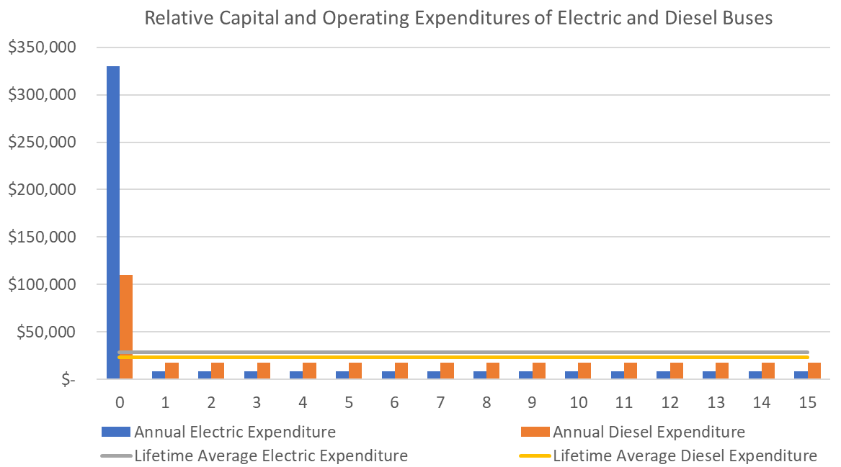
Electric costs are incurred differently
TCO delta, real $: $(110,000)
Upfront delta: $(220,000)
Average delta,
real $: $(7,300)
Source: WRI illustrative calculations (February 2022)
Notes:
Electric buses hit balance sheets differently than diesel buses do, with higher capital costs and lower operating costs
TCO delta is in real dollars (NPV of costs)

Slide 11
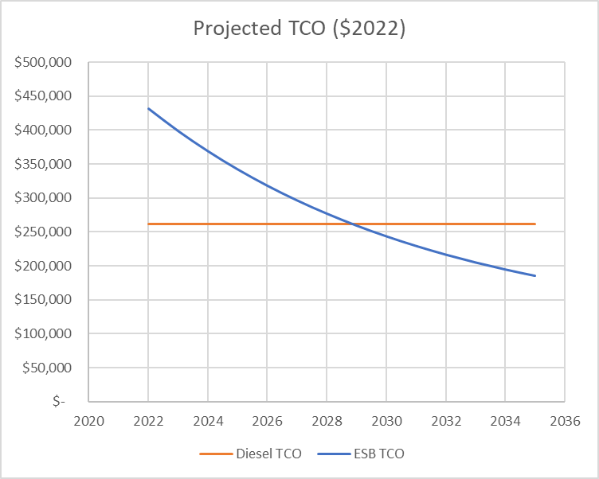
The costs of ESBs are declining
Price parity is projected by 2033 and TCO parity is projected by 2029 as:
Battery costs decline
Industry efficiencies of scale in component markets
Market prices are distinct from the prices districts pay due to government & utility subsidies
With incentives, many ESB purchases already achieve TCO parity with diesels
Source: WRI calculations (February 2022)
Notes:
Price parity projected by 2033
TCO parity projected by 2029
Subsidies today will not last forever, so now is the time!

Slide 12
Funding & financing have complementary roles
Public Funds Required
Overall Savings
Financing Required
Financing Required to Leverage Public Funds
2033 Price Parity
Source: WRI illustrative calculations (February 2022)
Notes:
Fleets transitioning today utilize public funding to improve purchase economics of ESBs
Electrification will generate overall savings for procurements in years after TCO parity is achieved
While the Total cost of ownership of buses is higher for electrics than for diesels, there will be a role for public funding. Fleets transitioning today utilize public funding to improve purchase economics of ESBs
As these upfront prices decline over the next few years, Electrification will generate overall savings for procurements. For some time, however, we can expect financing to play a role in helping districts fit the different cost profile of electric buses to their existing budgeting practices

Slide 13
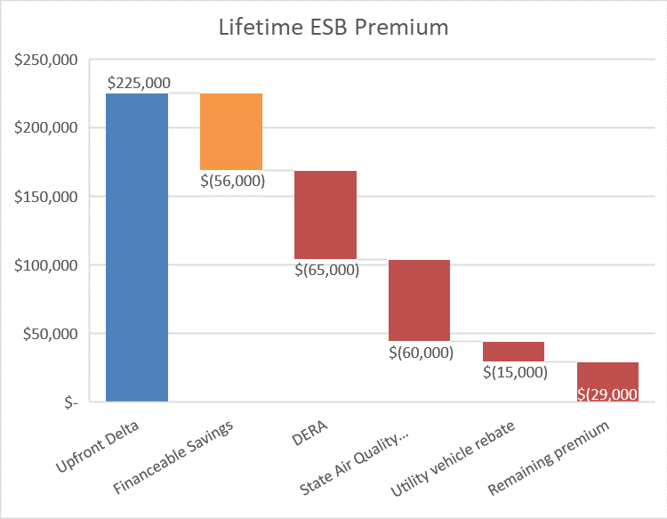
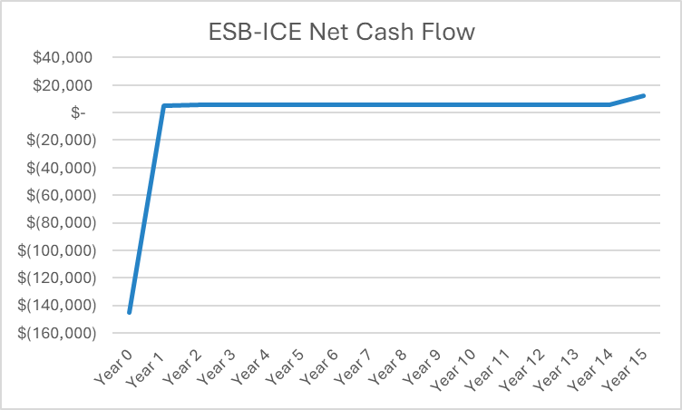
Financing provides capital today, for future repayment
Positive cash flow is the revenue for repaying loan
Source: WRI calculations (February 2022), illustrative grant program details & illustrative cash flow
Notes:
See the financeable portion of the upfront cost in ORANGE
We’re sticking a pin in that and will return later

Slide 14
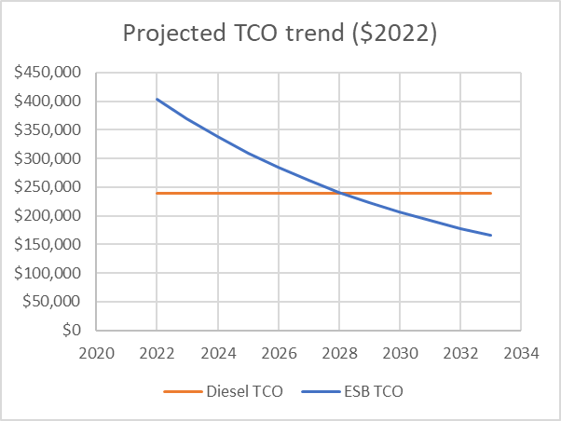
After TCO parity, ESBs can produce savings
Fleets transitioning today utilize public funding to improve purchase economics of ESBs
Funding can phase out as prices in the market decline
Financing can be expected to be useful at least until purchase price parity
Fleets beginning their electrification journeys now can benefit from capturing future savings in today’s plans
Require public funding
Generating lifetime savings
Source: WRI calculations (February 2022)

Slide 15
HOW TO UNDERSTAND BUSINESS MODEL OPTIONS
Identify assets
Consider ownership & stakeholders
Weigh risks & benefits

Slide 16
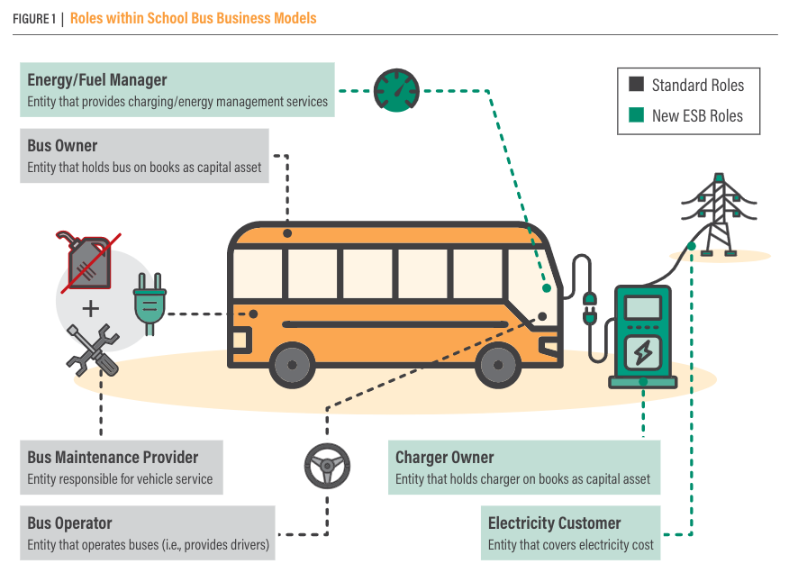
Roles within school bus business models
Notes:
Bus owner: the entity that holds the bus on its books as a capital asset
Charger owner: the entity that holds charger on its books as a capital asset
The owner of the customer-side infrastructure may be a distinct entity from the owner of the charger, such as a utility
The entity responsible for charger maintenance may be a distinct entity from the owner of the charger, such as an energy/fuel manager (see below)
Bus operator: the entity that operates the buses (aka provides drivers)
Bus maintenance provider: the entity responsible for scheduled and unscheduled service of the vehicles to enable optimal performance and extend lifetime
Energy/fuel manager: the entity that provides charging and energy management services including load management, monitoring state of charge, scheduling vehicle charging needs, sending/receiving grid signals, providing V2X energy flows

Slide 17
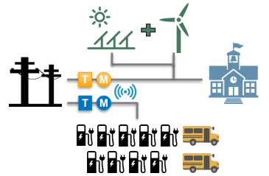
Project assets: hardware components of ESB projects
Distributed Energy Resources
Building energy load
Associated services:
Bus maintenance
Charger maintenance
Electric infrastructure
Buses & batteries
Chargers

Slide 18
Project assets: software components of ESB projects
Distributed Energy Resource Management System
Associated services:
Network contracts/ subscriptions
Onboard telematics
Charger/energy management software
Fleet management
software

Slide 19
There are still barriers for this transition
Exacerbated Challenges:
Access to capital, such as higher cost to borrow & lower tax base
Staff capacity to manage project
Underinvested local electrical distribution infrastructure
Outsize Benefits:
Air quality improvements result in greater local health benefits
Operational savings & revenue generation to support district priorities
Inclusion in green economy

Slide 20
Role: Bus Owner
Bus owner: the entity that holds the bus on its books as a capital asset
The owner of the bus, such as the district, may be a separate entity from the owner of the battery, such as a utility
Bus owner | Entities in the market
School District | Dealers, OEMs (purchase from)
3rd party | OEM (Lease from dealers, OEMs) Turnkey Asset Management TaaS Electric Utility

Slide 21
Considerations: Bus Owner Role
 | Benefits to district may include | Considerations for district may include | Project cost impact
School District | Can utilize district’s own low-cost capital if available Ability to specify vehicle characteristics | Technology performance issues outside of warranty terms are the responsibility of district | Large capital asset financed via public capital (~2%)
3rd party | Mitigates high upfront capital outlay of an ESB (3-4x > than diesel) Bulk procurement price Technology performance is guaranteed | Potential extended commitment via long-term contract May be asked to forgo potential revenue opportunities (e .g . vehicle-to-grid [V2G] payments) & lower future ESB costs | Large capital asset financed via private capital (~5-15+% estimated)
Remember that...
District ownership may be infeasible for underserved districts and/or those without access to low-cost capital or incentives

Slide 22
Role: Charger Owner
Charger owner: the entity that holds the charger on its books as a capital asset
An operational charger often requires additional infrastructure (e.g. conduit, panel, etc.) on the customer’s side of the meter
The owner of the customer-side infrastructure may be a distinct entity from the owner of the charger, such as a utility
The entity responsible for charger maintenance may be a distinct entity from the owner of the charger
Charger owner | Entities in the market
School District | Purchase from EVSE providers
3rd party | Electric Utility CaaS, IaaS TaaS, Turnkey Asset Management Energy Services Company

Slide 23
Considerations: Charger Owner Role
 | Benefits to district may include | Considerations for district may include
School District | Can utilize district’s own low-cost capital Can control all specifications Can integrate into any existing energy/fleet management systems | Technology performance is responsibility of district May be some learning lag as staff/district get accustomed to new role
3rd party | Mitigates the high upfront capital outlay of infrastructure Bulk procurement price Technology performance is guaranteed | Potential extended commitment via long-term contract May be asked to forgo potential revenue opportunities from electricity markets (e.g., V2G payments)
Project cost impact | Mid-size capital asset financed via public capital (~2%)* | Mid-size capital asset financed via private capital (~7-15+%)*
 | *Chargers are a smaller share of total project cost than buses themselves, so source of financing will have a smaller impact on total project cost than source of bus financing
Remember that...
District ownership may be infeasible for underserved districts and/or those without access to low-cost capital; utility ownership may result in costs borne by all electricity ratepayers

Slide 24
Role: Bus Operator
Bus operator: the entity that operates the buses – providing drivers and planning routes
Bus operator | Entities in the market
School District | Schools
3rd party | TaaS

Slide 25
Considerations: Bus Operator Role
 | Benefits to district may include | Considerations to district may include
School District | Comfort with standard role Better able to monitor and ensure safe and healthy conditions for drivers and students Investment in workforce and skills development | May be some learning lag as drivers adjust to new technology
3rd party | More flexible contract arrangement Driver performance is not district’s responsibility | Less insight into and influence over operating conditions for workers . These can vary widely: health insurance premium increases, wages (e .g . COVID-related increases) and training costs
Project cost impact | Minimal difference to total project cost – not a capital asset | Mid-size capital asset financed via private capital (~7-9%)
Remember that...
Improving working conditions will have outsized benefits to women, who are highly represented among bus drivers, monitors, and other bus-riding workers. Additionally, improving working conditions can help retain workers and attract new ones, especially from historically excluded communities
Source: Zippia 4/18/22 - driver data, monitor data, attendant data

Slide 26
Role: Bus Maintenance Provider
Bus maintenance provider: the entity responsible for scheduled and unscheduled service of the vehicles to enable optimal performance and extend their lifetimes
Bus operator | Entities in the market
School District | Schools
3rd party | TaaS, Turnkey Asset Management

Slide 27
Considerations: Bus Maintenance Provider
 | Benefits to district may include | Considerations to district may include
School District | Better able to ensure safe and healthy working conditions Absorb larger share of maintenance & repair savings generated by ESBs May provide greater job stability, quality, and training for school bus mechanics | May be some learning lag as staff adjust to new technology Maintenance costs may have some variability
3rd party | More flexible contract arrangement Repairs and unanticipated costs are not district’s responsibility | May result in less skills development for staff in ESB maintenance Under some arrangements repairs may require coordination, introducing potential for delay Maintenance & repair savings (as compared to diesel) may not be fully passed on to district
Project cost impact | Minimal difference to total project cost – not a capital asset | Mid-size capital asset financed via private capital (~7-9%)
Remember that...
Improving working conditions will have outsized benefits to Latino workers and workers without 4-year degrees, two groups that are highly represented among bus mechanics & technicians
Source: Zippia 4/18/22

Slide 28
Role: EnergyFuel Manager
Energy/fuel manager: the entity that provides charging and energy management services including monitoring state of charge, scheduling vehicle charging needs and managing load
Where applicable, this may also include sending and receiving grid signals and providing vehicle-to-everything (V2X) energy flows
Some chargers’ hardware providers include energy management software as part of their package
Bus operator | Entities in the market
School District | Schools
3rd party | Electric Utility CaaS, IaaS TaaS, Turnkey Asset Management Energy Services Company

Slide 29
Considerations: EnergyFuel Manager
 | Benefits to district may include | Considerations to district may include
School District | Absorb larger share of any potential revenues from electricity/environmental markets (e .g ., V2G revenues), where opportunities exist Investment in workforce and skills development Integrate vehicle with other facility or site energy management activities such as rooftop solar or peak shaving | Some learning lag as staff adjust to new technology Operating costs may have some variability
3rd party | Reduce cost variability for district by selling at a fixed fee and absorbing any unanticipated price deviations Specialized expertise and technology know-how | May be asked to forgo potential revenue opportunities from electricity markets (e.g., V2G payments) May lock-in particular technology or lose data if switch providers later
Project cost impact | Minimal difference to total project cost – not a capital asset | Mid-size capital asset financed via private capital (~7-9%)
Remember that...
Many districts, especially underserved districts, may not have staff capacity to dedicate themselves to energy management tasks

Slide 30
Role: Electricity Customer
Electricity Customer: the entity that pays for electricity consumed by the chargers
Electricity service will be provided by the utility, but contractual arrangements may assign electricity costs to an entity other than the account holder, depending upon the business model pursued
Bus operator | Entities in the market
School District | Provided directly by electric utility
3rd party | CaaS, IaaS TaaS, Turnkey Asset Management Energy Services Company

Slide 31
Considerations: Electricity Customer
 | Benefits to district may include | Considerations to district may include
School District | Realize larger share of fuel savings generated by ESBs Combine with renewables - onsite or via a Power Purchase Agreement (PPA) Potential revenue from electricity/environmental markets (e.g., V2G revenues) where opportunities exist | Some learning lag as staff adjust to new technology Operating costs may be unpredictable
3rd party | Reduce cost variability for district Combine with renewables (onsite or PPA) | May be asked to forgo potential revenue opportunities from electricity markets (e.g., V2G payments) Staff may not grow their capacity & skills in energy management Potential extended commitment via long-term contract
Project cost impact | Minimal to substantial depending on scale of available revenue streams – not a capital asset | Mid-size capital asset financed via private capital (~7-9%)
Remember that...
Underserved districts may not have flexibility in operating budgets to accommodate monthly/seasonal variability in electricity prices

Slide 32
Taxonomy of ESB Business Models
 | Roles within all business models |  | Roles that are specific to electrification
Business Models | Bus owner & maintenance | Bus operation | Charger owner (& Maintenance) | Energy manager (software) | Electricity Customer | Example (not exclusive)
Traditional | SD | SD | SD | SD or 3rd party | SD | Original model
Lease | 3rd party | SD | SD | SD or 3rd party | SD | OEM lessor/dealer + partner
Charging-as-a-Service | SD | SD | 3rd party | 3rd party | SD | Mobility House, Amply, Electric Utilities, ESCos
Turnkey asset management | 3rd party | SD | 3rd party | 3rd party | 3rd party | Highland, Levo, Dominion Energy
Transportation-as-a-Service | 3rd party | 3rd party | 3rd party | 3rd party | 3rd party | Zum, NYCSBUS, First Student

Slide 33
Defining the Contractual Relationship
Contracts formally assign responsibilities, duties, obligations and benefits across the roles and elements of each business model.
Contract Type | Definition
Ownership | A contract to purchase an asset outright
Lease Agreement | A contract for possession of a vehicle for a set period.
Service Agreement | A contract between a business and a customer covering the operation, maintenance or servicing of equipment over a specified period; this can include provision of software
Master Services Agreement | A contract that governs the procurement and provision of multiple services where the counterparty is an umbrella entity that manages underlying contracts and service agreements.
Energy Savings Performance Contract | A contract to finance energy-saving improvements or facility upgrades using generated savings to pay for the project
Sources: Oxford dictionary, Texas Comptroller, County Government of Montgomery County, MD, LawDepot
Notes:
Each business model will be made up of elements codified through contracts

Slide 34
QUESTIONS TO GUIDE BUSINESS MODEL DISCUSSIONS
What are your community’s and district’s values? What are your intended outcomes for electrification?
How can your business model advance these values and goals to promote an equitable process and outcome during electrification?
How much capital does your district have access to? This may entail applying for grants, rebates, vouchers, etc.
Can you access private capital to leverage this public capital, and what is the cost to do so? How might these capital sources address district capacity and staffing needs?
Will your district be able to financially sustain the investments over the long-term through appropriations for the costs of maintenance, service fees or other operational costs?
How much financial or technology risk (& potential for upside) is your organization comfortable with?

Slide 35
QUESTIONS TO GUIDE BUSINESS MODEL DISCUSSIONS
What impact will each model have on your existing workforce? For each model you are considering, how will you:
Prevent job loss/disruption or wage decreases for incumbent employees,
Promote recruitment and retention, and
Ensure that workers have the training they need to drive, maintain, and/or repair ESBs?
What is your workforce’s capacity?
To manage vehicle and infrastructure procurement, deployment, maintenance and operations?
How are procurement decisions made?
Various stakeholders (e.g. financiers, utilities) will need to be engaged. Some, like building and energy managers, may be new to transportation decisions.
Different risks and benefits will resonate with different decisionmakers in the procurement process.
Are there potential mechanisms through which buses in your area could generate revenues, such as electricity markets, utility programs, or environmental credits?

