Slide 1
DEMYSTIFYING FINANCE: OPPORTUNITIES TO SCALE THE ADOPTION OF ELECTRIC SCHOOL BUSES
Notes:
Hi everyone, thank you for joining us for today’s webinar. Today we’ll be talking about financing solutions to support and scale the adoption of electric school buses. These financing solutions might look like bonds, loans, leases, or other investments that can be paid off over a period of time, and that can be paired with other federal, state, local and private grants, rebates and vouchers. As more school districts look for ways to fund electric school buses, we want to share the full range of options that can make the transition to an electric bus fleet a reality.

Slide 2
LOGISTICS
This webinar is being recorded
Please put any questions in the Q&A box. We will address as many as we can throughout the webinar​
We’ll send you the slides and webinar recording after the event
Notes:
Please also note that the webinar is being recorded. A copy of the recording, the slides, and additional resources will be shared with all those who attend today.
Feel free to start dropping any questions you have in the Q&A box; we will do our best to answer as many questions as possible in the time we have today.

Slide 3
Coalition of dozens of non-profit organizations
Dedicated to ensuring an equitable transition, prioritizing the communities most impacted by diesel pollution and the workers making the transition possible
Providing resources to educate decision makers and help communities advocate for a #CleanRide4Kids

Slide 4
Clean Energy Works accelerates the adoption of inclusive utility investments to transform the power, building, and transportation sectors by providing advisory services, policy and regulatory support, outreach and engagement, and research
We build bridges between community champions, leading utility executives, and policy-makers to create bright spots of innovation in the power sector

Slide 5
We aim to:
Partner with communities, school districts, industry experts, manufacturers, utilities, and policy makers to transform and electrify the school bus market
Together, build unstoppable momentum to electrify 480,000 school buses in the U.S. by 2030
Ensure an equitable transition by focusing on underserved communities
Notes:
WRI's ESB Initiative is supported by a grant from our establishing partner, the Bezos Earth Fund and started its work in 2020.
Our Initiative aims to build unstoppable momentum toward an equitable transition of the U.S. school bus fleet to electric by 2030, in collaboration with partners and communities, to bring health, climate and economic benefits to children and families across the country while normalizing electric mobility for an entire generation.
To make this transition a reality, together, our team has developed an array of resources for school districts, manufacturers, electric utilities, policymakers, community members and more. These are all free resources. We will drop the link to our website that houses these resources in the chat.
One specific resource I want to draw attention to for school districts and contractors is our explainer on the Tax Credit for Qualified Commercial Clean Vehicles (section 45W). This credit covers up to $40,000 for an ESB. Tax exempt entities, like schools, qualify to receive credit as direct payment. We will drop link in the chat to this resource as well. Inflation Reduction Act of 2022 Tax Credit for Qualified Commercial Clean Vehicles (section 45W) An Explainer v3.pdf (electricschoolbusinitiative.org)

Slide 6
AGENDA
Funding & Financing Insights
USDA Community Facilities Program Presentation
Fireside Chat
Audience Q&A
Zoom Poll
Closing
Notes:
For today, we'll start with an overview from WRI on their latest research report on funding and financing. Then we'll turn it over the USDA to talk about their Community Facilities Program. After that we'll begin our panel discussion, moderated by our friends at Clean Energy Works. The panel discussion will include a Q&A portion, so again, please feel free to drop questions in the chat and we'll get to them soon. We'll then do a quick poll to get feedback from all of you and then close out our webinar!

Slide 7
FUNDING AND FINANCING INSIGHTS
Notes:
Briefly we will touch on total cost of ownership of an ESB and the role funding and financing can take in scaling the transition to electric.

Slide 8
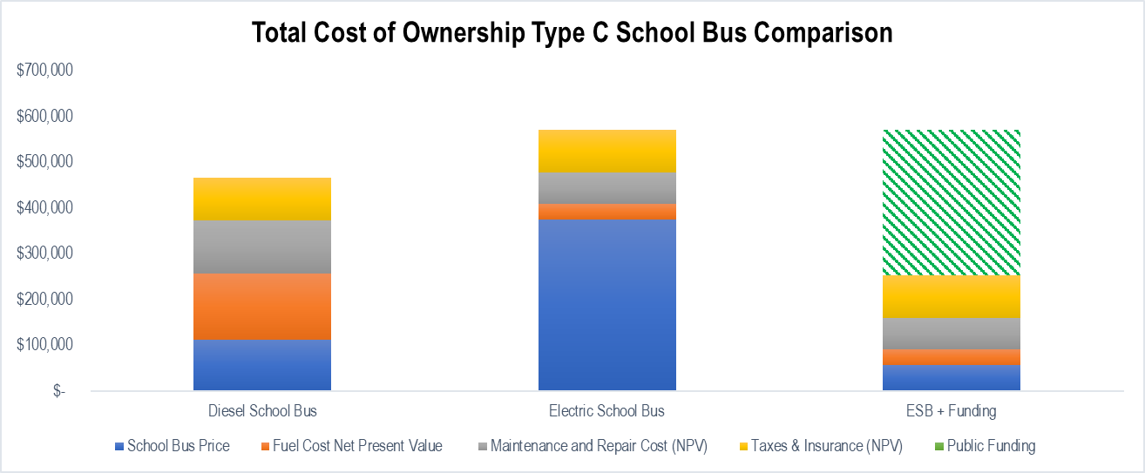
Government funding has decreased total cost of ownership for electric school buses
$596,000
$467,000
$278,000
Note: Illustrative example based on average grant awards for Type C buses.
Source: Recommended Total Cost of Ownership Parameters for Electric School Buses: Summary of Methods and Data Technical Note methodology, 2023 values; Lazer and Freehafer, September 2023; WRI analysis, October 2023
Notes:
First let's look at total cost of ownership for a school bus. Total cost of ownership consists of upfront capital costs of the vehicle (and in the case of electric, charging infrastructure) and the lifetime operations and maintenance costs.
This illustrative example at the national level uses 2023 bus prices.
As you can see, without incentives, the total cost of ownership of an ESB is $129,000 more than its diesel counterpart. This is where funding has come in to facilitate the transition to electric.
State and federal funding for electric school buses has grown dramatically in recent years, increasing from a total of $280 million allocated by 2020 to over $9.3 billion by 2023 (Atlas Public Policy, July 2023; WRI analysis, October 2023).
From analysis of the funding awarded for the purchase of an ESB from 2017 to 2023, we find an average award of $318,000 ($317,814) for a Type C ESB. This reduces the ESB TCO to $278,000 making it less than a diesel over the vehicle's lifetime. With the funding options available today, the TCO for electric school buses can not only bring ESBs to parity with diesel but actually be hundreds of thousands of dollars less than the TCO of a diesel-burning school bus – saving districts money that they can reinvest in the classroom.
It is important to note that prices for electric school buses are expected to decrease within the upcoming years, parity with diesel without incentives is expected within the next decade.

Slide 9
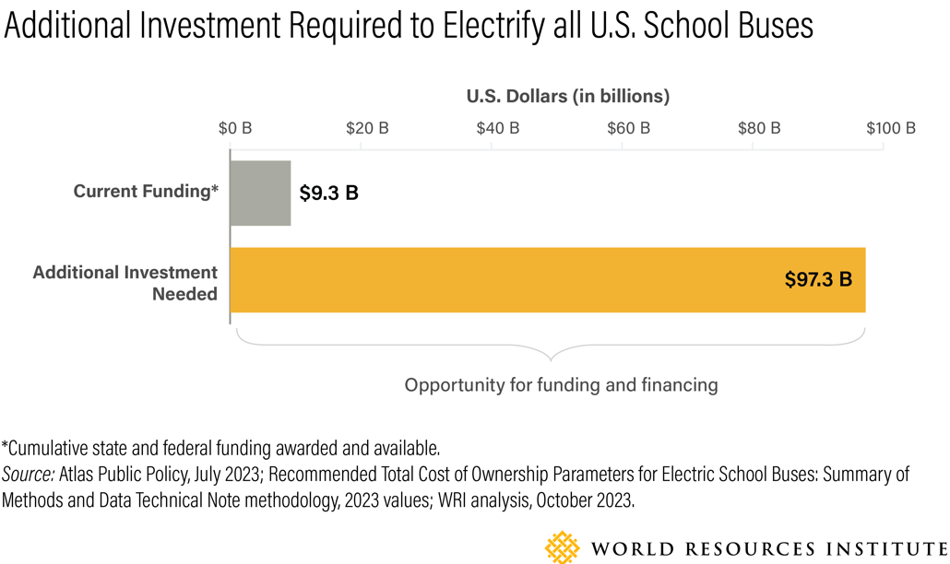
But funding alone is not enough. Enter finance.
Additional Investment Required to Electrify All US School Buses (at 2023 prices)
For ESB only. Assumed bus MSRP of $375,000 (2023) and applies 45W $40,000 tax credit.
Notes:
Though we have seen a historic amount of investment in this transition and as amazing as that has been to see government's commitment to clean ride for kids, as you can see in this graphic, funding alone is not enough.
Our analysis finds that the current funding available of $9.3 bn can cover up to 41,900 electric school buses at current prices. This is less than 10% of the U.S. school bus fleet, which is estimated to have 480,000 school buses.
The estimated costs to electrify the remaining U.S. school bus fleet, 438,100 school buses, is approximately $97.3 billion based on 2023 bus prices (Recommended Total Cost of Ownership Parameters for Electric School Buses: Summary of Methods and Data Technical Note methodology, 2023 values). This estimate accounts for $40,000 per bus to account for the IRA Commercial Clean Vehicle Credit (45W) and $113,000 per bus to account for school district budget allocation for the replacement of a diesel bus.
Again, it is important to note that prices for electric school buses are expected to decrease within the upcoming years so the additional investment need to electrify may be much less.
However, currently, this current gap of $97.3 in capital is where we see opportunity for additional funding and finance to come in.

Slide 10
ESBs OFFER LIFETIME OPERATIONAL AND FUEL SAVINGS that can BE FINANCED
Source: Recommended Total Cost of Ownership Parameters for Electric School Buses: Summary of Methods and Data Technical Note methodology, 2023 values; WRI analysis, October 2023
Notes:
How can school districts leverage financing to cover the higher upfront capital costs of transitioning?
Due to low electricity prices and fewer maintenance needs, in this example it is estimated electric school buses can reduce operational costs by more than $150,000 over their lifetime, compared to their diesel counterparts, using national averages of costs.
Districts can then monetize the future maintenance and fuel savings and apply these towards the initial capital investments that electric buses require. These savings can be financed and allow districts to restructure school bus electrification costs so that they more closely resemble the operational budget and cash flow characteristics of incumbent diesel vehicles and can enable districts to make the investments necessary to realize cost-effective projects.

Slide 11
FINANCING MECHANISMS
Private Loans
Public Loans
Bonds
Leases
As-a-service Firms
Inclusive Utility Investments
Sources: Powering Electric School Bus Adoption with Complementary Funding and Financing Solutions | Electric School Bus Initiative
Notes:
Financing Options
How can I finance ESBs?
These are some examples of financial mechanism schools can consider as they start thinking of financing.
There are different types of financial institutions, besides commercial banks, that offer and support these mechanisms:
Green Bank leverage public and private capital to invest in innovative and sustainable projects, which may be overlooked by traditional financial institutions, to accelerate the transition to clean energy and reduce emissions.
OEM financing services
State financing authorities
Please check out our newest article on funding and financing mechanism that goes over each of the following financing mechanisms and provide examples of their use.

Slide 12
SCHOOL DISTRICTS SHARE INSIGHTS AND EXPERIENCES WITH FINANCING to procure school buses
51% of respondents said they would not have enough liquidity to cover out-of-pocket costs for electric school buses & infrastructure, in cases where funding opportunities do not cover the full costs
35% of respondents have considered utilizing financing to procure school buses
Common financial mechanisms considered or implemented include leasing to purchase agreements (6), bonds (8), revolving funds (3), loans with commercial bank (2)
Main factors that influence the selection of a financial mechanism include interest rates, customer service and flexible financial terms
Questionnaire respondents:
31 school districts across 17 states
Sources: Electric School Bus Initiative Financial Solutions Questionnaire Results, October 2023
Notes:
We know there are only a couple cases where school districts utilized financing to acquire ESBs. However, we know that schools are not unfamiliar with financial mechanisms. We launched a questionnaire to inquire about school districts’ experiences and considerations.
These are some of the main findings:
35% stated that have considered financing to buy school buses.
These includes lease to purchase agreement, bonds, revolving funds, loans with commercial banks.
The main considerations involve interest terms, flexible financial terms, and customer service.
In an event where grant funding does not cover the costs of ESB, half of respondents said that they don’t have the liquidity to cover costs out-pockets.
Please keep in mind that this is only a representation of 31 school districts, we’ll continue to accept responses and learn more about considerations.

Slide 13
USDA Community Facilities Program
Notes:
Now we'd like to introduce Stan Hale, an Asset Risk Management Specialist for the Community Facilities Program at the U.S. Department of Agriculture. Stan has been in the financial and banking industries for the last 36 years, including as a commercial lender for several regional banks in the Montgomery, Alabama area. Stan spent most of his career with community banks, until joining USDA Rural Development in 2010 as a Community Programs Specialties in the State Office in Montgomery until 2020. Through his work now with the Community Facilities Program, Stan oversees eight states for technical assistance, underwriting support and underwriting preparation and presentation to the Loan Committee.

Slide 14
Community Facilities Programs
Stan Hale, Asset Risk Management Specialist

Slide 15
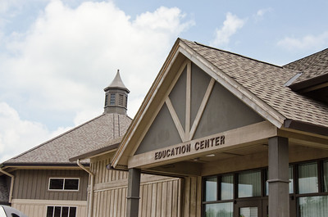
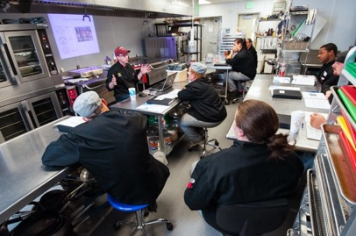
Community Facilities Programs Overview
Offers direct loans, loan guarantees and grants to develop or improve essential public services and facilities
Eligible Applicants: Public Bodies, Non-Profits, Indian Tribes
Eligible Purposes: Construct, expand, renovate, or improve facilities that provide health care, education, public safety, and public services
Populations of 20,000 or less
Applications are taking year-round.
Each state has a Rural Development State Office
www.rd.usda.gov

Slide 16
Contact Information
Stan B. Hale
Asset Risk Management Specialist
Community Facilities Programs
United States Department of Agriculture
4121 Carmichael Road, Suite 601
Montgomery, Alabama 36106
Phone: 334.279.3616
Mobile: 334.223.3056
Email: stan.hale@usda.gov
www.rd.usda.gov

Slide 17
FIRESIDE CHAT

Slide 18
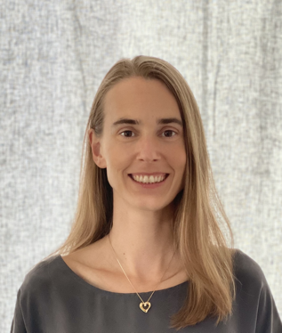
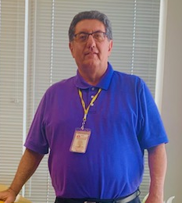
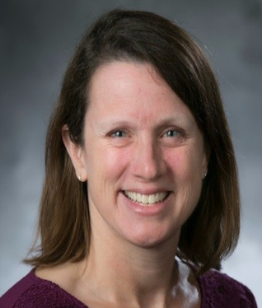
TODAY's Panel
Kirsten Stasio
Chief Executive Officer
Nevada Clean Energy Fund
Kris Hafezizadeh
Executive Director of Transportation
and Vehicle Services
Austin Independent School District
Jennifer Weiss
Co-Director
North Carolina Clean Energy Fund

Slide 19
THANK YOU
Alliance for Electric School Buses, carolina@chaconconsulting.com
Clean Energy Works, margarita.parra@cleanenergyworks.org
Electric School Bus Initiative, esbinfo@wri.org

