Slide 1
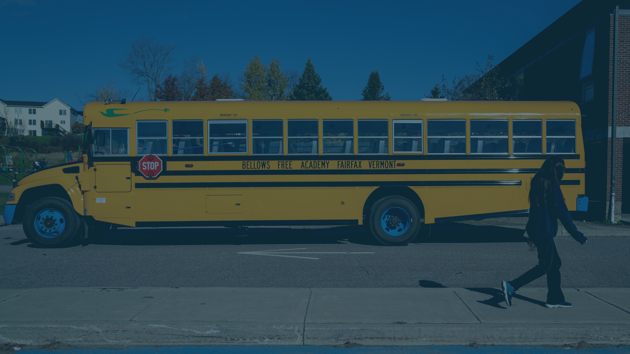
Add in your logo by left clicking the image > select “change picture” > and select you logo image file
SCHOOL DISTRICT/NAME HERE
WHY ELECTRIC SCHOOL BUSES?
A better way forward

Slide 2
Delete this slide before presenting.
WHO IS THIS DESIGNED FOR?
Why Electric School Buses Presentation Template
Administrative or transportation leads looking to educate stakeholders on the benefits of electric school buses.
WHAT DOES THIS DECK INCLUDE?
Information on the downfalls of diesel buses, the benefits of electric school buses, and key next steps on moving forward.

Slide 3
Delete this slide before presenting.
HOW TO USE THIS?
Identify the goals of the presentation and select the relevant slides in this deck that can help you convey that message. ​
Read the instruction callout on each slide, update the slide contents as needed, and then delete the callout. ​
Enter “Slide Show” mode by clicking on the Slide Show icon in the bottom right.
Update and add any content outside of the instructions to help convey your message.​
Review speaker notes on each slide for talking points or additional information.​
Put this presentation in your school’s standard template (if applicable) and delete this slide before presenting.​
If you have suggestions or comments, please contact our team on our website at https://www.wri.org/initiatives/electric-school-bus-initiative
Why Electric School Buses Presentation Template

Slide 4
THE HIGH COST OF DIESEL BUSES

Slide 5
Adjust the time spent on a bus to the right number for your community.
THE HIGH COST OF DIESEL BUSES
20+ minutes
10X the pollution
Children spend between 20 minutes to several hours a day on school buses.
Pollution levels inside older diesel buses can exceed surrounding areas by 5 – 10 times.
Environment & Human Health, Inc.
Notes:
Presenter Speaking Notes: Our students are spending up to xx minutes / hours on buses every week. A report from Environment and Human Health Inc. found that pollution levels inside older buses can exceed surrounding areas by up to ten times.
Source: https://www.ehhi.org/reports/diesel/dieselintro.pdf

Slide 6
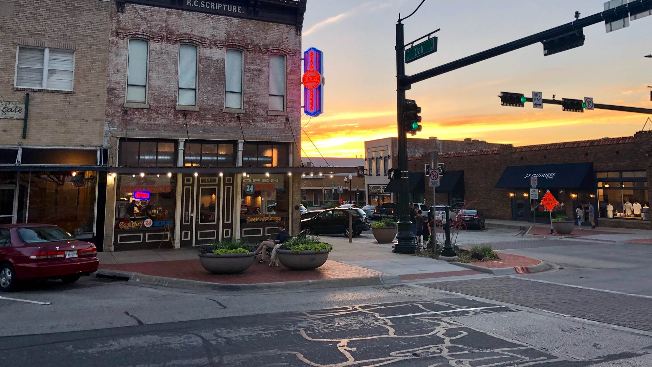
THE HIGH COST OF DIESEL BUSES
Exposure to diesel emissions has been shown to negatively impact cognitive and respiratory health in children.
Diesel exhaust is classified as a carcinogen.​
Children are more susceptible
to the harmful
effects of diesel emissions.
Exposure to diesel emissions has been shown to negatively impact cognitive and respiratory health in children.
NOx CO PM VOCs
The International Agency for Research on Cancer
The International Agency for Research on Cancer
EPA
Economics of Education Review
Notes:
Presenter Speaking Notes: There is no known safe level of diesel exposure for children. According to the EPA and numerous other studies, children are more susceptible to the harmful effects of diesel emission because they have higher breathing rates and their lungs are still developing.
In addition to being a known carcinogen, exposure to diesel emissions has been shown to impact cognitive and development respiratory health in children. Causing illnesses that result in absences and leading to cognitive impairment.
Sources:
https://www.epa.gov/dera/reducing-diesel-emissions-school-buses
https://cpb-us-w2.wpmucdn.com/sites.gsu.edu/dist/f/528/files/2019/08/Bus_EER.pd https://www.ncbi.nlm.nih.gov/pmc/articles/PMC4835031/

Slide 7
Adjust fuel costs and number of older buses to reflect accurate numbers for your school / district.
To calculate fuel costs, you can use $7K as the annual average fuel costs for each diesel bus per year.
THE HIGH COST OF DIESEL BUSES
$XXX in fuel a year
XX older buses
We spend $xxx every year to fuel our buses.
We have xx buses that are over ten years old and will likely need to be replaced in the next five years. Aging diesel buses are expensive to maintain and have increased pollution levels.
Notes:
Presenter Speaking Notes: The downfalls of diesel buses also extend to the costs to maintain buses. [insert name of school district] spend roughly $xxx on fuel each year to run our fleet. Additionally, we have an aging fleet. The usually diesel bus is retired at 16 years. Meaning that we have xxx buses that will need to be replaced in the next five years of less.
What’s more, older buses are expensive to keep on the road and have increased pollution levels.
Data verification for fueling amount: The average school bust travels 12,000 miles annually and gets ~7 miles per gallon. At ~$3.50 per gallon that's about $7,000 annually on fuel per bus.)
Source for average retirement age for buses: According to a survey by 'School Bus Fleet,' the average school bus us 9 years old and retired at 16 years.

Slide 8
WHY SCHOOLS ARE GOING ELECTRIC
Notes:
Presenter Speaking Notes: So let’s talk about why schools are going electric.

Slide 9
WHY SCHOOLS ARE GOING ELECTRIC
HEALTHIER FOR OUR STUDENTS, DRIVERS, AND COMMUNITY
REDUCED FUEL, OPERATION, AND MAINTENANCE COSTS
SAFE, RELIABLE, AND QUIET
Notes:
Presenter Speaking Notes: There are three main reasons we see more and more schools transitioning to electric school buses.
Electric school buses are cheaper over time.
They are safe and reliable.
They are healthier for our students and our community.

Slide 10
REDUCED COSTS OVER TIME.
“TRAN­SI­TION­ING TO ELECTRIC WOULD MAKE A MAS­SIVE POS­I­TIVE IM­PACT ON SCHOOL COST-SAV­INGS.
Volunteer of Mothers Out Front, Westchester, NY
Notes:
Presenter Speaking Notes: First we are going to talk about costs.
Source: https://thehudsonindependent.com/electric-school-buses-to-roll-out-for-westchester/

Slide 11
REDUCED COSTS
The total cost of owning an electric school bus can be hundreds of thousands of dollars lower than for diesel-burning school buses.
Electric school buses are more efficient to operate compared to diesel buses.
Electric school buses can save schools $6,000 annually in fuel and maintenance costs.
WRI’s Electric School Bus Initiative
Fueleconomy.gov
WRI’s Electric School Bus Initiative
Notes:
Presenter Speaking Notes: With more funding available than ever before, the total cost of ownership for electric school buses can be lower than for diesel-burning school buses. Electric school buses are more efficient to operate, meaning 77-90% of the electrical energy pulled from the grid (or elsewhere) is used to power the vehicle's wheels. In internal combustion engines, most of the energy stored in the gasoline or diesel is lost to heat and friction. Only about 25-40% of the energy stored in the diesel is used to power the vehicle's wheels. World Resource’s Electric School Bus Initiative has estimated electric school buses can save school districts $6K annual in both fuel and maintenance costs.
Sources:
Costs:
https://afdc.energy.gov/fuels/prices.html)
Anecdotal data from schools districts with ESBs:
https://www.nytimes.com/2020/01/22/business/energy-environment/electric-school-buses.html
https://www.etransenergy.com/Thought-Leadership/Electric-School-Bus-Fleet
https://www.wri.org/research/recommended-total-cost-ownership-parameters-electric-school-buses-methods-data
https://electricschoolbusinitiative.org/all-about-total-cost-ownership-tco-electric-school-buses
Efficiency:
https://www.fueleconomy.gov/feg/evtech.shtml
https://theicct.org/the-ever-improving-efficiency-of-the-diesel-engine/

Slide 12
BENEFITS OF ELECTRIC
A school district operating an ESB can expect to see over $100,000 in lifetime fuel and maintenance savings, compared to an diesel bus.
Nearly 70% of spending on electricity remains within local and regional economies.
Opportunities for vehicle-to-grid and vehicle-to-building integration can improve school district resilience.
WRI's Electric School Bus Initiative
Southern Alliance for Clean Energy
Notes:
Presenter Speaking Notes: According to World Resources Institute’s Electric School Bus Initiative, a district operating an electric school bus can see over $100,000 in lifetime savings. Electric investments also stay within our community. Finally, electric school bus batteries can feed electricity back into nearby buildings and the electric grid, increasing community resilience and the value of the buses to schools and local utilities.’
Sources:
Nearly 70% > https://cleanenergy.org/blog/electric-vehicles-could-add-47-billion-annually-to-southeast-economy and also: https://www.mdpi.com/2032-6653/8/4/996/pdf
https://electricschoolbusinitiative.org/all-about-total-cost-ownership-tco-electric-school-buses

Slide 13
SAFE AND RELIABLE.
“THE ELECTRIC BUSES ARE VERY WELL MANUFACTURED, DRIVE SMOOTHLY, AND PERFORM WELL.”
School bus driver in San Diego

Slide 14
MAINTENANCE SAVINGS
Fewer moving parts in an electric school bus engine vs. a diesel engine means less to repair.
Maintenance savings of up to 60% over diesel school buses.
Fleet staff must be trained and supported through the transition to realize these savings.
School Bus Fleet
Dominion Energy
Notes:
Presenter Speaking Notes: Diesel buses are known for being difficult and expensive to maintain. With electric buses there are fewer moving parts so there is less to break and repair. This leads to maintenance savings of up to 60%. To ensure our school realizes these savings we will want to support fleet staff through the transition to electric school buses.
Sources:
https://www.schoolbusfleet.com/10139866/electric-school-bus-maintenance-key-similarities-differences
https://news.dominionenergy.com/2020-01-16-Dominion-Energy-Moves-Forward-with-Electric-School-Bus-Program;
Lion Bus predicts maintenance savings of 60% over diesel
Thomas Bus predicts savings of $4,400 annually
The Clinton Global Initiative predicts savings of $4,400 annually (cited here: https://uspirg.org/sites/pirg/files/reports/US_EL%20buses%202021%20scrn.pdf).

Slide 15
HEALTHIER FOR KIDS AND COMMUNITIES AND
BETTER FOR THE PLANET.
“IT’S WONDERFUL NOT HAVING TO VISIT THE DIESEL PUMP EVERY DAY AND HAVE TO INHALE THOSE FUMES.”
School bus driver in San Diego

Slide 16
HEALTHIER KIDS AND COMMUNITIES
Air quality on buses is not regulated by the EPA.
Electric school buses have zero tailpipe emissions.
Electric school buses could improve the air quality inside and outside the bus.
Notes:
Presenter Speaking Notes: Electric school buses do not emit tail pipe emissions improving the air quality within and outside the bus.

Slide 17
If you select the following slide, please delete this slide.
BETTER FOR THE PLANET
Electric Buses Reduce GHGs
Full electrification has a big impact
On a lifecycle basis, electric school buses produce less than half the greenhouse gas emissions of diesel-burning school buses.
Electrifying the full U.S. school bus fleet by 2030 would reduce greenhouse gas emissions by 9 million metric tons per year, the equivalent of taking 2 million cars off the roads.
WRI’s Electric School Bus Initiative
WRI’s Electric School Bus Initiative
Calculation using AFLEET (2020) and includes fuel lifecycle and vehicle operations. Uses the NREL Electrification Futures Study low cost renewables 2030 national average values, and assumes annual bus mileage of 14,084 miles, the same distribution of bus sizes found in the 2022 fleet orders, and no changes from current fuel efficiencies of either fuel type.
Notes:
Presenter Speaking Notes: Electric school buses produce the lowest levels of greenhouse gas emissions of any school bus type, even when accounting for emissions generated in production of the electricity used to power the buses. Electrifying the full U.S. school bus fleet by 2030 would reduce greenhouse gas emissions by 9 million metric tons per year, the equivalent of taking 2 million cars off the roads.
Source:
https://electricschoolbusinitiative.org/evidence-clear-electric-school-buses-are-best-choice-reduce-emissions

Slide 18
Alt Slide to Focus on Your Impact. To generate the GHG savings refer to presenter notes.
You can calculate your GHG savings here: https://afleet.es.anl.gov/hdv-emissions-calculator/
BETTER FOR THE PLANET
We could save xx% of GHG
Full electrification has a big impact
By converting out fleet to electric school buses we could save xx% of GHG annually.
Electrifying the full U.S. school bus fleet by 2030 would reduce greenhouse gas emissions by 9 million metric tons per year, the equivalent of taking 2 million cars off the roads.
WRI’s Electric School Bus Initiative
Calculation using AFLEET (2020) and includes fuel lifecycle and vehicle operations. Uses the NREL Electrification Futures Study low cost renewables 2030 national average values, and assumes annual bus mileage of 14,084 miles, the same distribution of bus sizes found in the 2022 fleet orders, and no changes from current fuel efficiencies of either fuel type.
Notes:
Presenter Speaking Notes: By converting our fleet to electric school buses we could save xx GHG annually. Electrifying the full U.S. school bus fleet by 2030 would reduce greenhouse gas emissions by 9 million metric tons per year, the equivalent of taking 2 million cars off the roads.
Source:
https://electricschoolbusinitiative.org/evidence-clear-electric-school-buses-are-best-choice-reduce-emissions

Slide 19
WHERE WE GO FROM HERE

Slide 20
Add the average milage for routes.
Remove cold-weather point if this does not apply to your location.
RANGE ALIGNMENT
Our average route is xx miles and the nameplate range of current electric school bus models is 75 - 210 miles.
ELECTRIC SCHOOL BUSES CAN MEET [INSERT NAME] DISTRICT’S NEEDS
COLD-WEATHER FRIENDLY
There are different heating options to accommodate cold climates.
CHARGING OPTIONS
We can evaluate optimal charging to meet route needs.
Notes:
Presenter Speaking Notes: Electric school buses meet the needs of our school / district. Our typically routes fall within the range of the buses. There are options to meet the needs of cold climates like ours and we will determine the best charging scenarios to meet our unique needs.

Slide 21
THE TIME IS NOW
As of August 2023, nearly 6,000 electric school buses have been committed in all 50 states, as well as tribal communities and multiple territories.. But with the vast majority still being diesel, now is the time to be delivering this innovation to our district.
LEADING SCHOOL DISTRICTS ARE MOVING TOWARD ELECTRIC SCHOOL BUSES
GROWING MARKET
All major school bus manufacturers are now making electric school buses which allow us to determine the optimal technology for our school.
Notes:
Presenter Speaking Notes: School districts in every state have committed to electric school buses. But the vast majority of buses are still diesel. Moving to electric school buses now shows our school a commitment to innovating and improving.
Operationally, it is easier to covert to electric buses now. All major school bus manufactures are making ESBs, giving us options to select the best technology for our school.

Slide 22
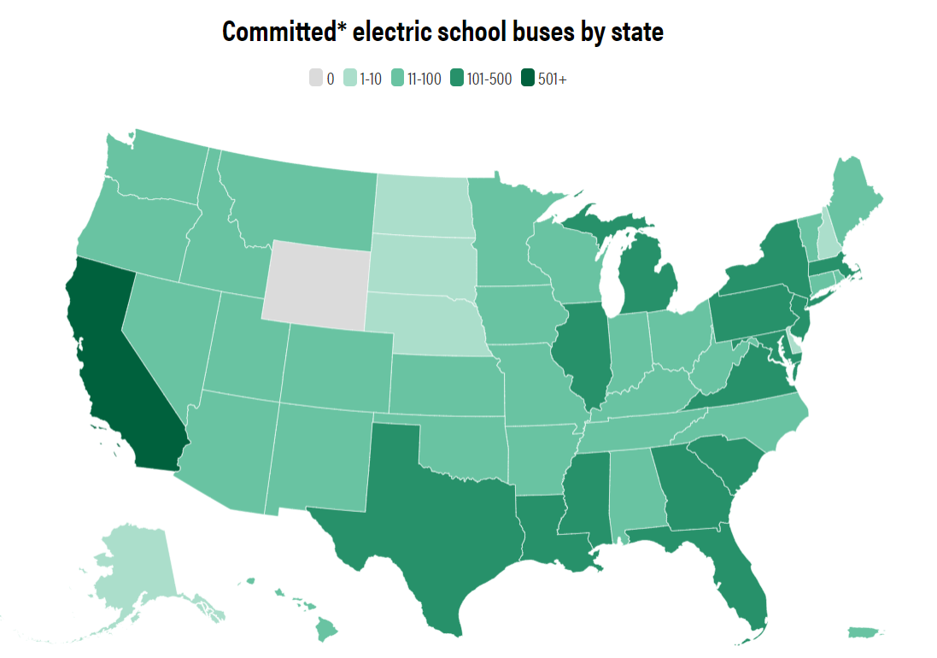
WHERE CAN YOU FIND ELECTRIC SCHOOL BUSES TODAY?
Electric school buses are operating in every type of community, and nearly 6,000 have been committed to in 49 states, as of August 2023.
Leading state commitments:
California: 2,078 electric school buses
Maryland: 391 electric school buses
New York: 304 electric school buses
WRI’s Electric School Bus Initiative
Notes:
Presenter Speaking Notes: Electric school buses are on the road or on the way to nearly every state in the nation, as well as tribal communities and several territories.
Source: https://electricschoolbusinitiative.org/state-electric-school-bus-adoption-us

Slide 23
LEVERAGING FUNDING TO OFFSET COSTS
ACCESSING FUNDING TO BRING ELECTRIC BUSES INTO OUR FLEET
The upfront cost of an electric school bus is 3 x more than a diesel bus but there is record funding available to bring down the costs.
Notes:
Presenter Speaking Notes: Electric school buses are more expensive than diesel buses but there is more and more funding being allocated to bring down the upfront costs of a bus.

Slide 24
Gain input from community and school stakeholders
Engage school bus contractor if using one
Engage with electric utility
Identify routes that can easily be supported by an electric bus
Assess our site for charging
Secure funding
Procure buses and install chargers
Track metrics (cost savings, emissions) and report on benefits
OUR NEXT STEPS
Feel free to edit or customize the steps based on where you are in the journey
Notes:
Presenter Speaking Notes: Here are our key next steps in moving forward.

Slide 25
OUR NEXT STEPS
Alternative slide to illustrate the roadmap to electrification.
3 to 6 months
12 – 24 months
Ongoing
ROADMAPPING
Visioning & market study
Community & stakeholder engagement
Funding & financing research
Roadmap creation
PLANNING & PROCUREMENT
Facility & site assessment
Operations, fleet & infrastructure plans
Procurement evaluation & RFI / RFPS
CHARGING INFRASTRUCTURE
Utility coordination for rates & interconnection requirements
Bus depot upgrades & solar pairing
Charger instillation & evaluation
TESTING & TRAINING
Fleet & equipment testing
Driver & mechanic training
DEPLOYMENT & SCALING
Fleet deployment
Monitoring, training & reporting
Community outreach & sharing of lessons learned
Scaling strategy
Notes:
Presenter Speaking Notes: Electric school buses are more expensive than diesel buses but there is more and more funding being allocated to bring down the upfront costs of a bus.

Slide 26
HERE TO HELP
WRI’s Electric School Bus Initiative
VEIC
Name
Email
Phone number
Name
Email
Phone number

Slide 27
THANK YOU

