Slide 1
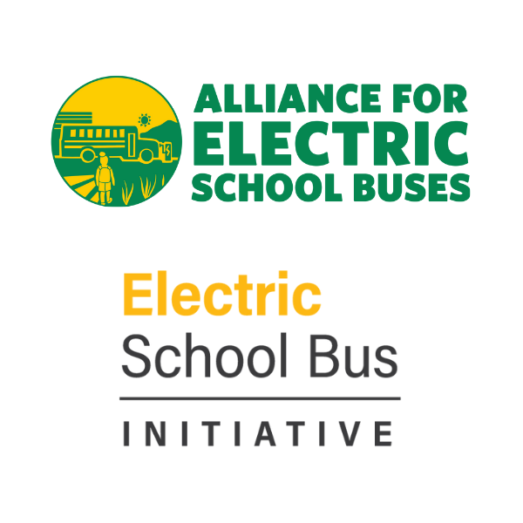
STEERING THE TRANSITION: ELECTRIC SCHOOL BUS DRIVERS
September 26, 2023

Slide 2
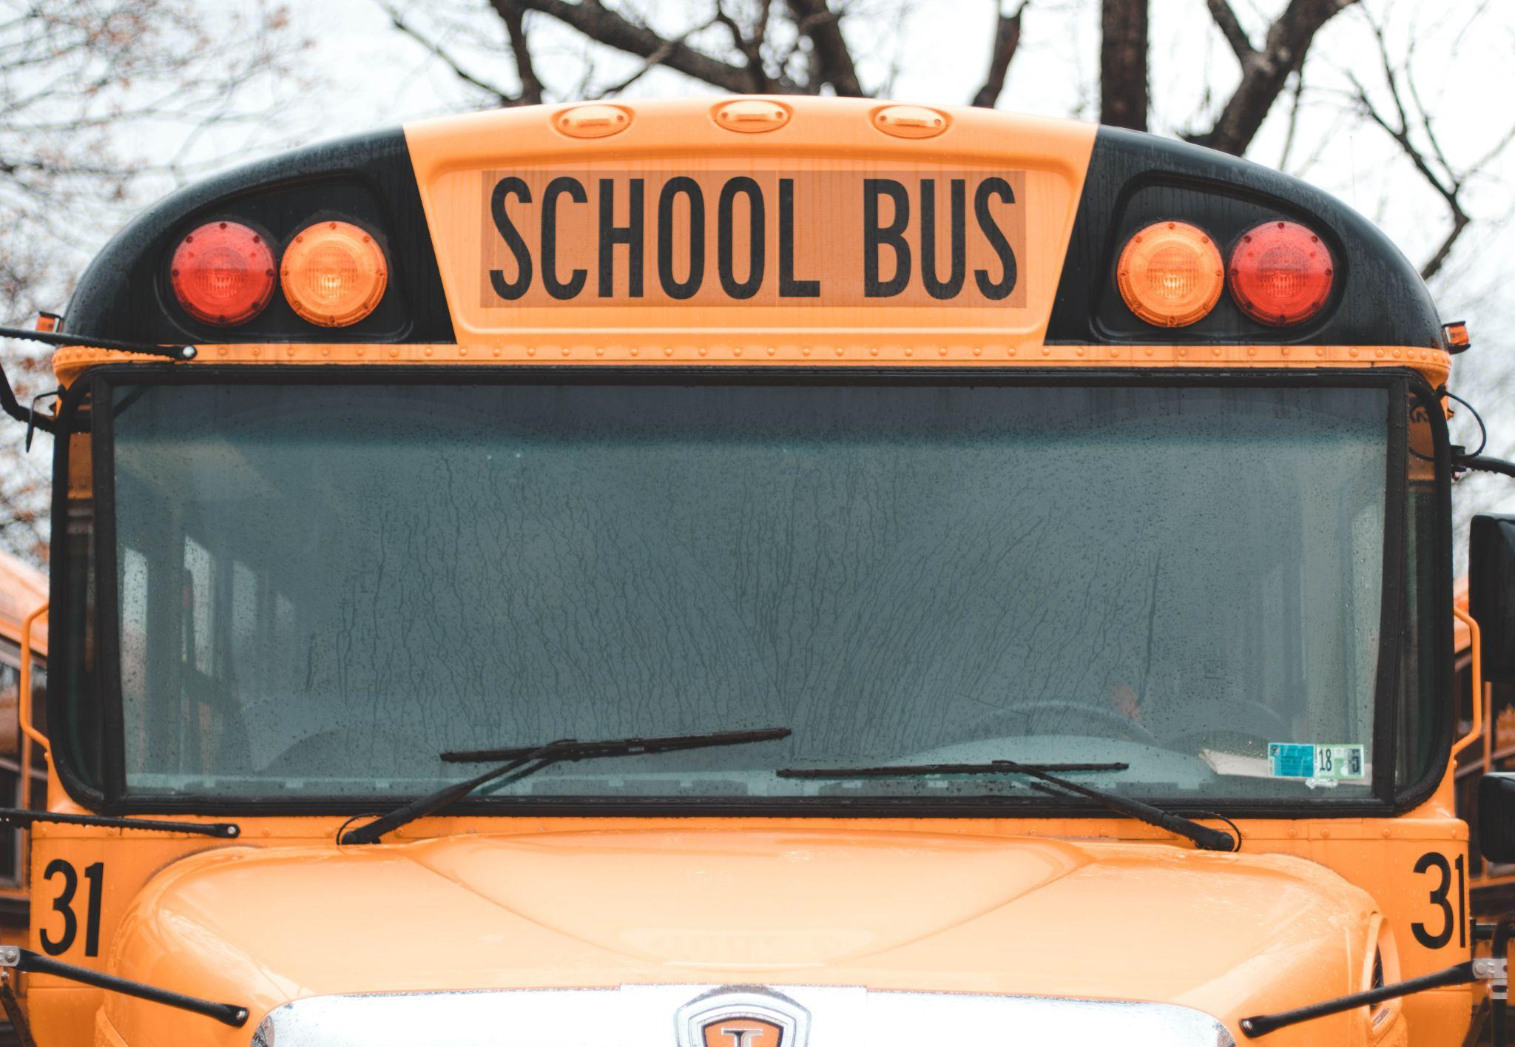
HOUSEKEEPING & LOGISTICS
Closed captions are available
This webinar is being recorded
Please put any questions in the Q&A box; we will address as many as we can later in the webinar
We’ll send you slides and the webinar recording after the event
Image Credit: Austin Pacheco - Unsplash

Slide 3
WRI’s Electric School Bus Initiative
Partner with communities, school districts, industry experts, manufacturers, utilities, and policy makers to transform and electrify the school bus market
Together, build unstoppable momentum to electrify 480,000 school buses in the U.S. by 2030
Ensure an equitable transition by focusing on underserved communities

Slide 4
Coalition of dozens of non-profit organizations doing work in 38+ states and federally -- secured over $10 billion in federal and state funding so far
Dedicated to ensuring an equitable transition, prioritizing the communities most impacted by diesel pollution and the workers making the transition possible
Providing resources to educate decision makers and help communities advocate for a #CleanRide4Kids

Slide 5
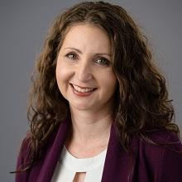
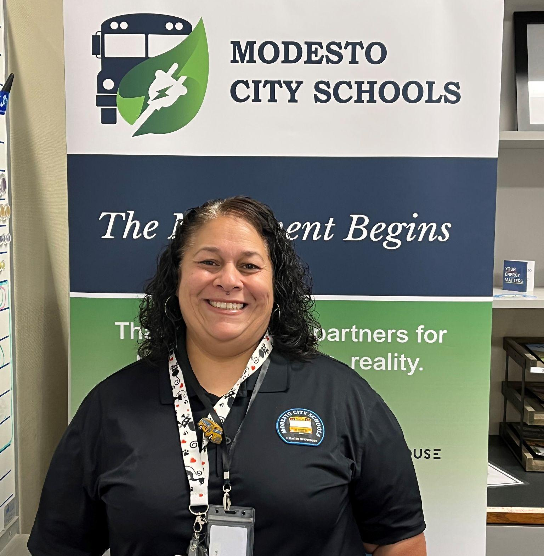
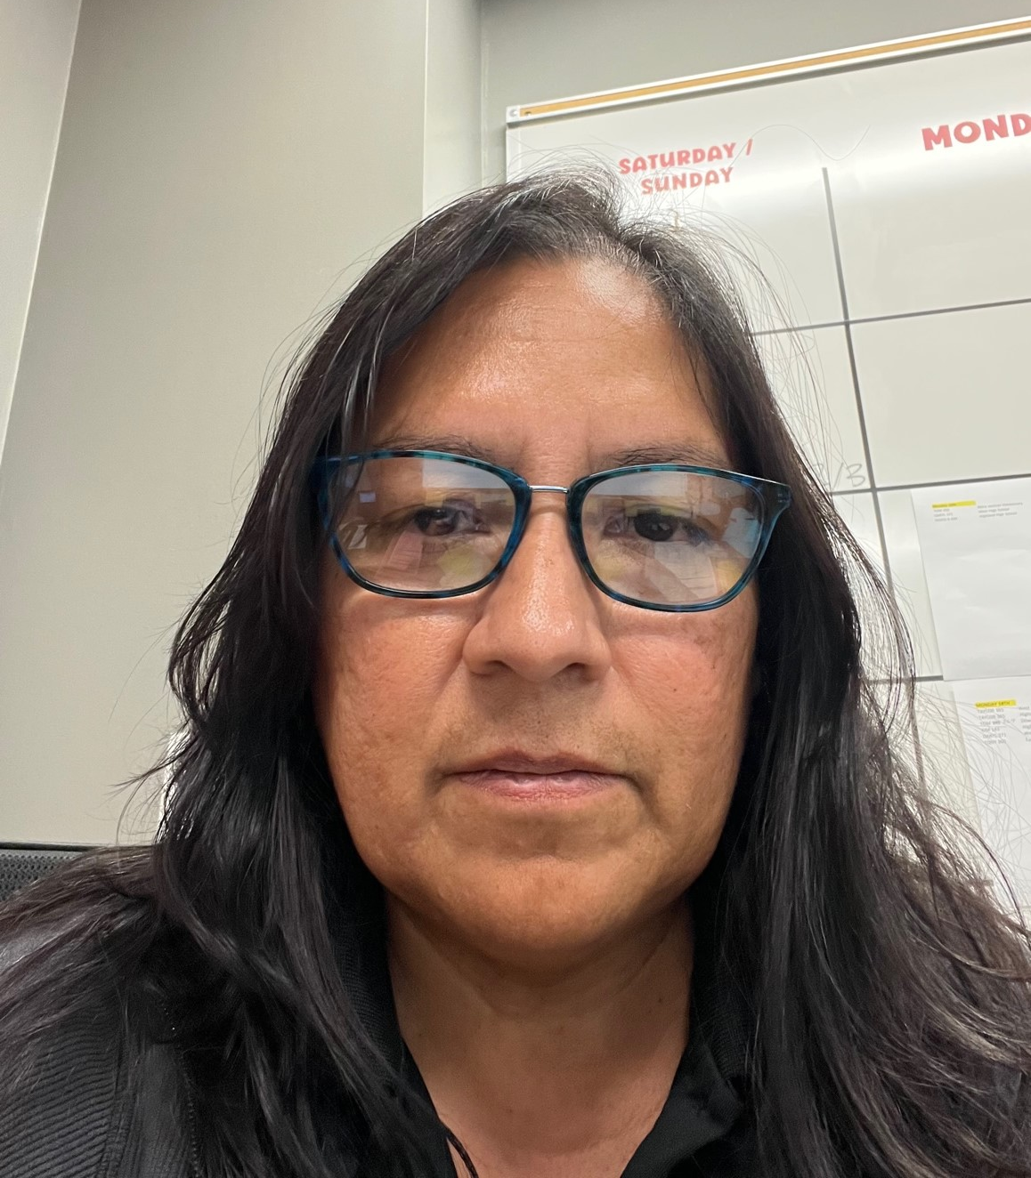
TODAY WE’LL HEAR FROM…
Brittany Barrett
Senior Manager, E-Mobility
School District Technical Assistance
WRI
Moderator
Trish Rea
Bus Driver and Trainer
Three Rivers Community Schools
Carmen Pena-Duran
Bus Operator
Modesto City Schools
Margarita Villalobos
ESB Pilot Driver
Salt Lake City School District
Carolina Chacon
Coalition Manager
Alliance for Electric School Buses

Slide 6
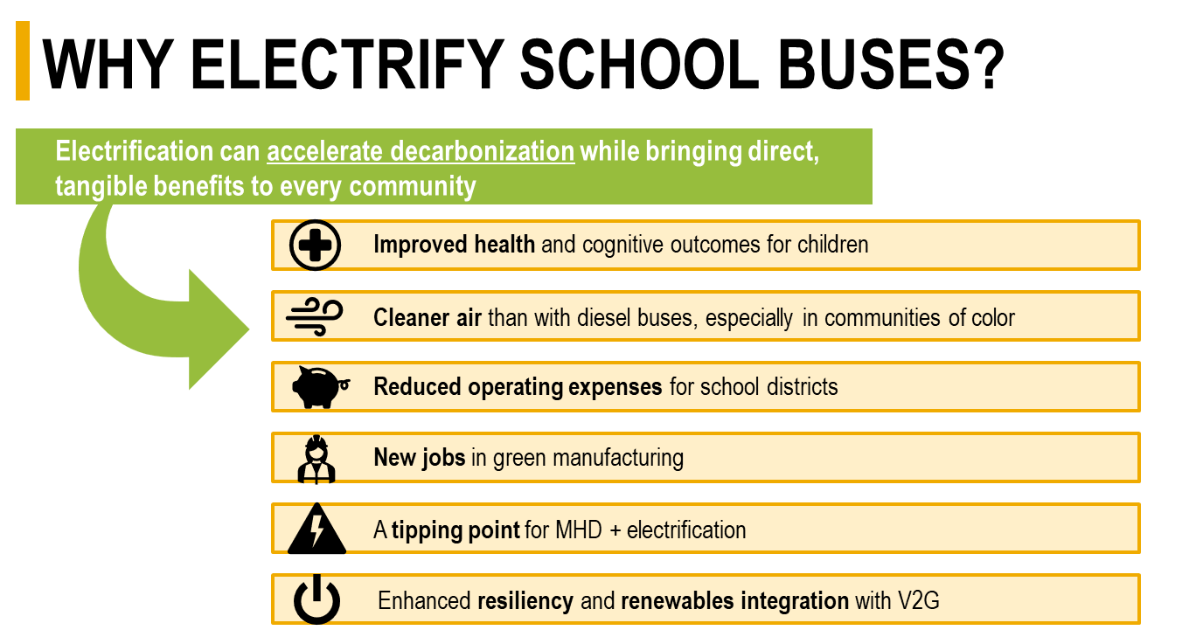

Slide 7
HARMS OF DIESEL EXHAUSTION
Diesel exhaust pollutants can lead to asthma, cancer and other respiratory illnesses.
Diesel exhaust pollution is a known carcinogen.
There are documented negative impacts on both student health and academic performance – and there is increasing evidence that children are particularly susceptible.
Reducing students’ exposure to air pollution from school buses has positive and significant effects on some test scores.
Sources: EPA; Beatty and Shimshack; Austin, Heutel and Kreisman; Liu and Grigg; WHO.

Slide 8
INEQUITABLE HARMS
60% of low-income students take the bus compared to 45% of non-low-income students
Fine PM exposure from on-road sources can be 75% higher for Latinos, 73% higher for Asian Americans, and 61% higher for African Americans
Native American children are 1.5 times more likely to have asthma as non-Hispanic white children.
SLIDE IN DEVELOPMENT
Sources: Bureau of Transportation Statistics, Union of Concerned Scientists, Public Health Report

Slide 9
CHALLENGES FACING ELECTRIFICATION
Higher upfront costs
Infrastructure development
Learning new technology
Technology myths
Need to scale quickly
These disproportionately impact underserved communities

Slide 10
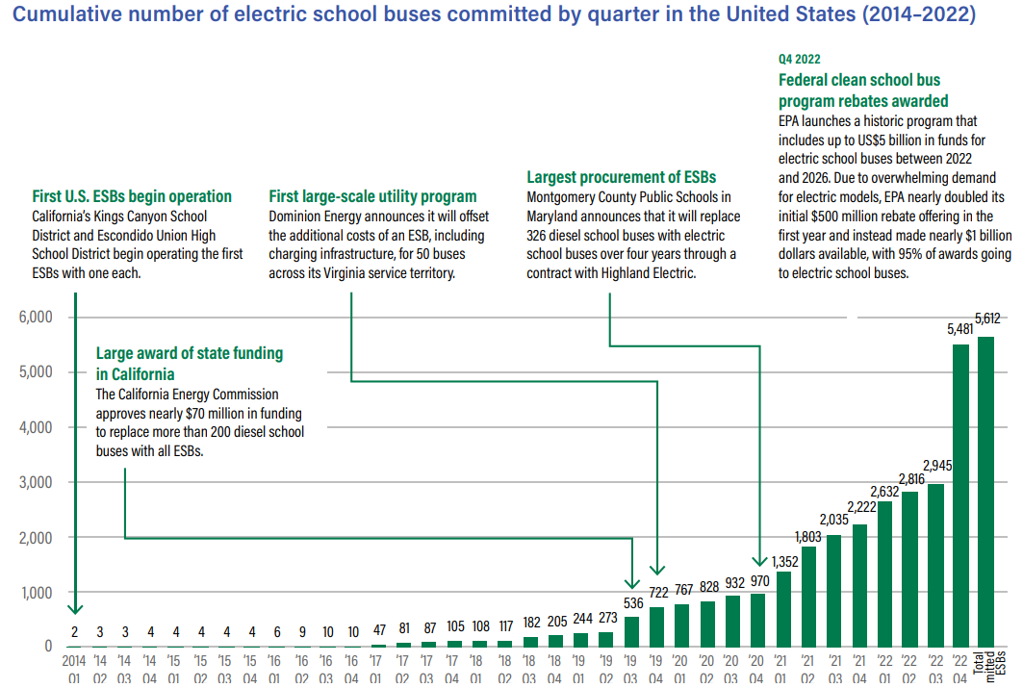
CUMULATIVE ELECTRIC SCHOOL BUS ADOPTION
Source: WRI Electric School Bus Market Report, July 2023

Slide 11
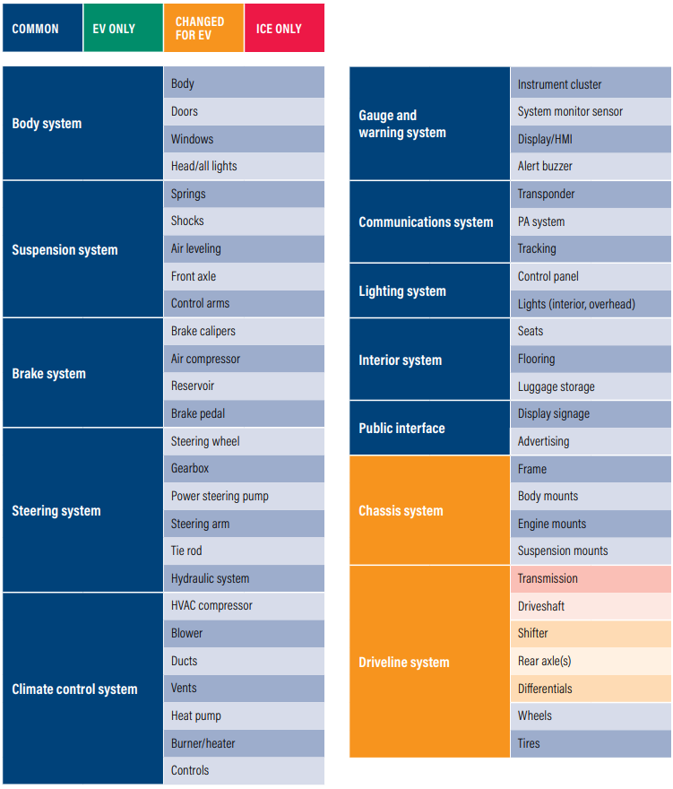
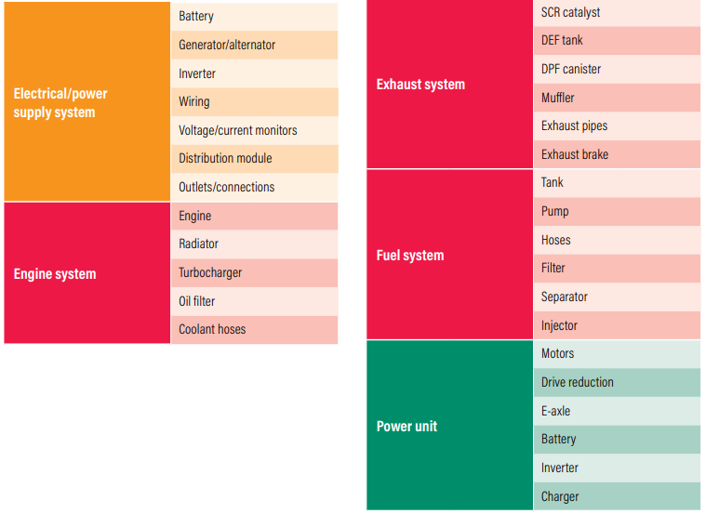
ELECTRIC SCHOOL BUSES: WHAT’S THE SAME? WHAT’S DIFFERENT?
Source: WRI Electric School Bus Market Report, July 2023

Slide 12
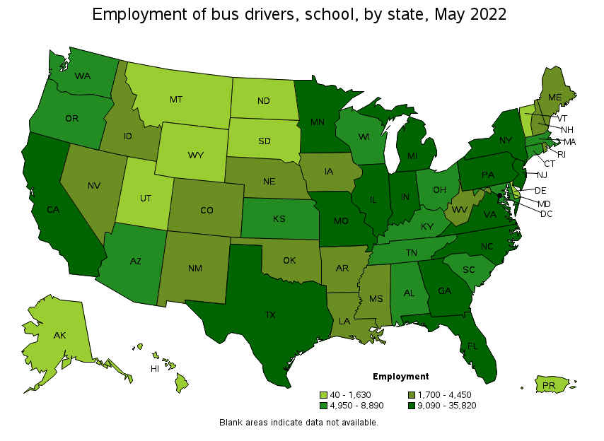
SCHOOL BUS DRIVERS WORKFORCE
366,550 school bus drivers in the U.S.
States with the highest # of school bus drivers:
New York: 35,820
Texas: 28,250
Pennsylvania: 21,830
Source: Bureau of Labor Statistics https://www.bls.gov/oes/current/oes533051.htm#(9)

Slide 13
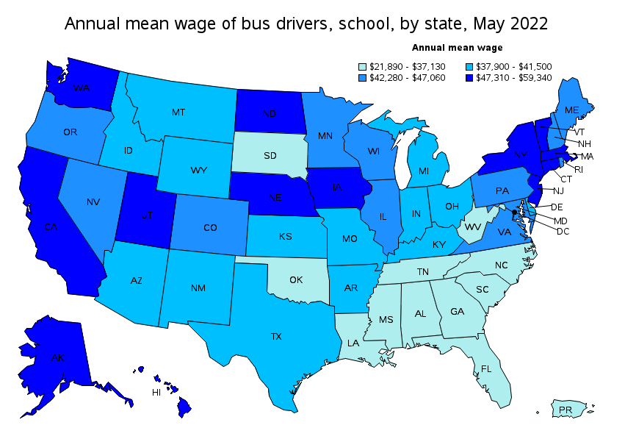
SCHOOL BUS DRIVERS WORKFORCE, CONT.
Mean hourly wage: $20.39 Mean annual wage: $42,400
Industries with the highest # of employed school bus drivers:
Elementary and Secondary schools: 193,220
School and employee bus transportation companies: 125,740
Local government: 32,480
Source: Bureau of Labor Statistics https://www.bls.gov/oes/current/oes533051.htm#(9)

Slide 14
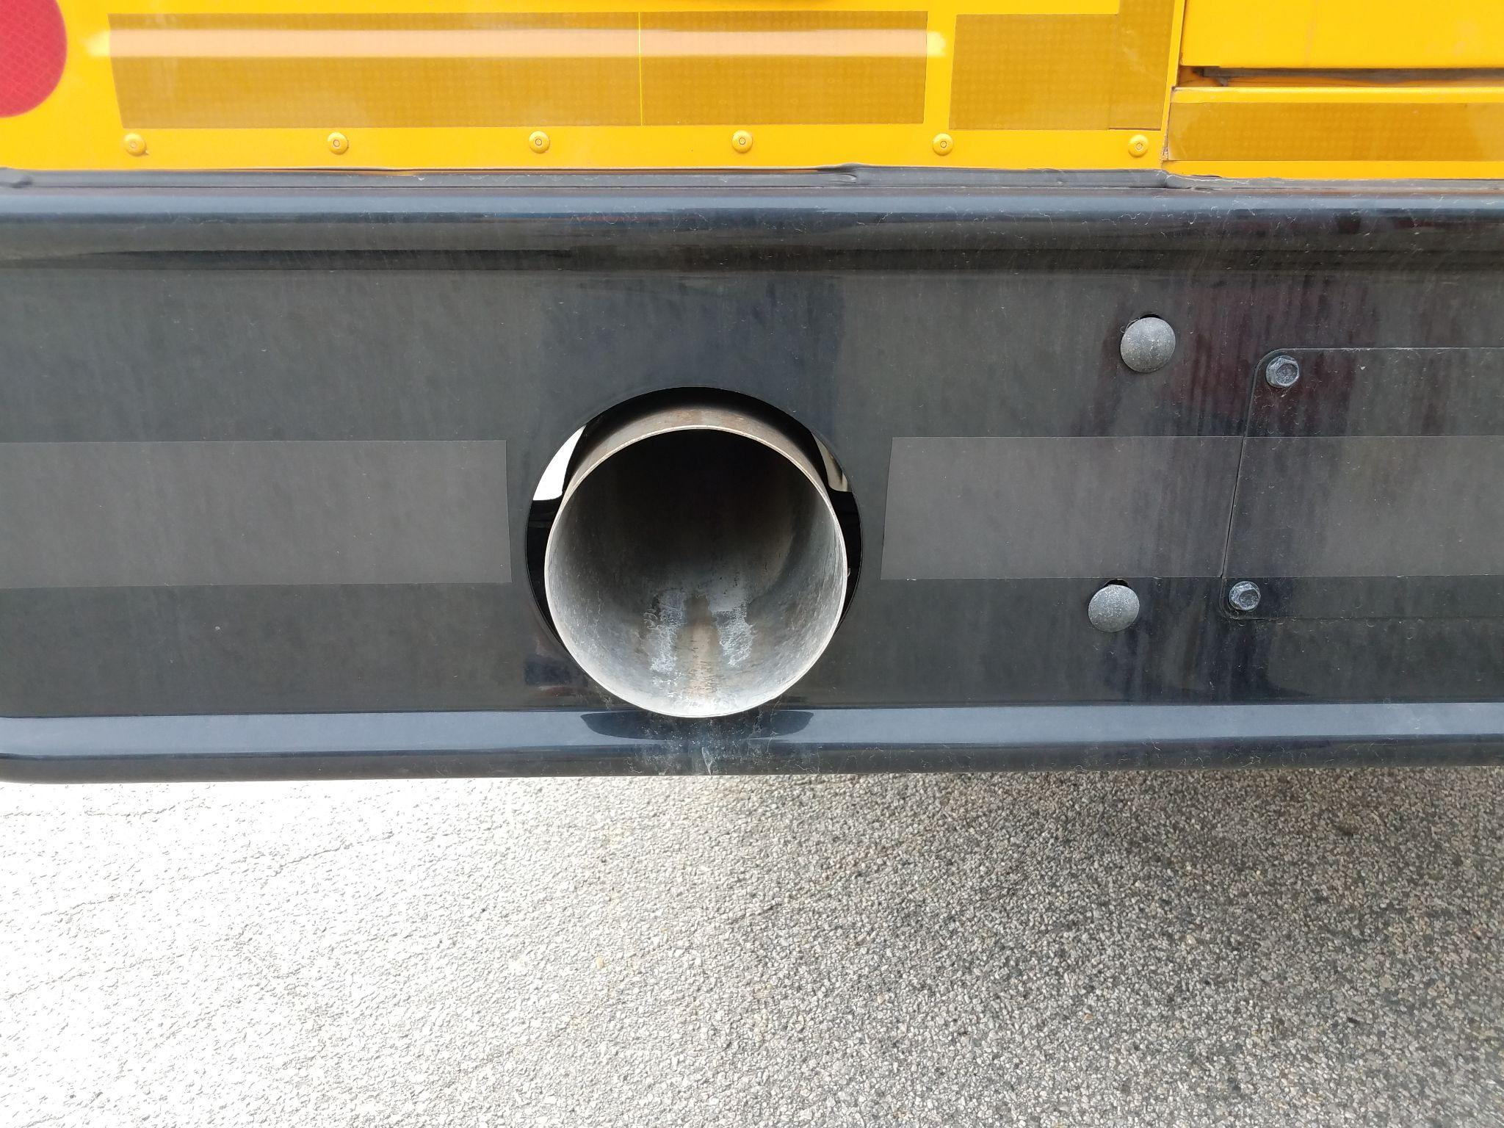
A NOTE ON AIR QUALITY
The status quo - a national school bus fleet that is 90% diesel buses - exposes drivers to harmful pollutants
Air pollutant levels inside school buses can be greater than ambient levels outside the bus; PM2.5 levels are four times higher aboard school buses than ambient levels.
Bus emissions intrude into the bus cabin, leading to these elevated levels. This is called “self-pollution.”
Electric school buses are the only school bus type with no tailpipe emissions - meaning no driver exposure to pollutants!
Sources: https://www.edf.org/sites/default/files/5342_School_bus_pollution_studies.pdf; Source: Adar, Sara D., Mark Davey, James R. Sullivan, Michael Compher, Adam Szpiro, and L-J. Sally Liu. "Predicting airborne particle levels aboard Washington State school buses." Atmospheric Environment 42, no. 33 (2008): 7590-7599.

Slide 15
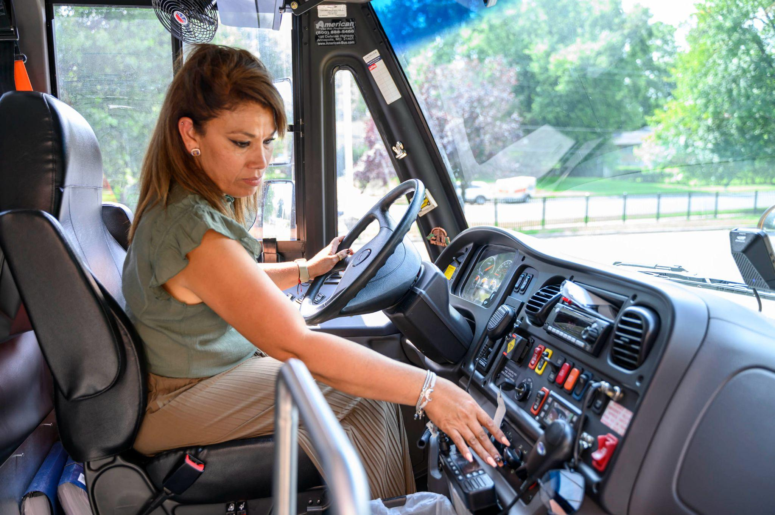
WHAT’S DIFFERENT ABOUT DRIVING AN ESB?
No tailpipe emissions. ESBs are better for your health!
Quieter
Regenerative braking
Faster acceleration
Battery state-of-charge (vs. gallons of fuel)
Charged using the depot charger or a public charger
Letting first responders know that the bus is electric in the event of an accident or incident

Slide 16
TRAINING AVAILABILITY & NEEDS
Manufacturers and dealers typically provide training to school bus operators upon delivery of the ESB
Operators with prior electric vehicle experience will have transferable skills for ESBs
Programs exist for ESB training, but they vary in quality

Slide 17
BEST PRACTICES FOR TRAINING & PROCURING TRAINING
Training of staff should be negotiated in purchase agreements and contracts
Consider deep training of a few staff for a train-the-trainer approach
Consider potential turnover and ensuring that training is spread between staff

Slide 18
SCHOOL BUS DRIVER SHORTAGE
Affecting districts in every state
Exacerbated by the pandemic
Electric school buses offer a better working environment - and have been used as a recruiting tool for drivers
Source: https://www.usatoday.com/story/news/education/2023/08/15/school-bus-driver-shortage-2023/70516560007/

Slide 19
THANK YOU
Visit our websites:
Alliance for Electric School Buses: www.electricschoolbuses4kids.org
WRI’s Electric School Bus Initiative: www.electricschoolbusinitiative.org

